Slide 1
Continuous In-Network Round-Trip Time Monitoring
with DART
Sata Sengupta, Joon Kim, Jennifer Rexford
Cabernet

Slide 2
Continuous RTT Monitoring is Useful
+ 15,000 km (50 ms)
Data
Data
I own client’s prefix
Request
Detect and Stop
[Arnbak et al., Tech Law Review 2015]
[Birge-Lee et al., ACM CCS 2019]
Notes:
Continuous RTT monitoring is useful in many cases. In one example, let’s consider a client and a server communicating within the US.
An adversary in Europe launches a BGP interception attack, and causes the data to get rerouted through him.
This is because he wants to perform web fingerprinting or steal cryptocurrency.
This attack can be done in sophisticated ways where traditional defense mechanims do not work.
We observe, however, that the data travels an extra 15,000 km that takes at least 50 ms more.
It would be great if we could leverage this increased round-trip time to detect and stop this attack.

Slide 3
What do we Need?
Real-time RTT
Continuous RTT
Accurate RTT
Risk increases per intercepted packet
Throughout the connection
False positives and negatives are costly
Notes:
What do we need to achieve this?
We need to measure RTTs in real time so we can take action before too many data packets have been intercepted by the attacker.
We need to measure RTTs continuously throughout the lifetime of the connection, as opposed to at the beginning or periodically.
We need to measure RTTs accurately because false positives can raise false alarm and worse yet, false negatives can result in us missing the attack.

Slide 4
RTT Measurement Techniques
Active measurements (e.g., ping, traceroute, iperf)
Passive measurements
Vantage point
Request
Probe query
Response
Measurement host
Probe response
Client
Server
Server
Characterize the network
User-experienced RTT
User-experienced RTT
Real-time, continuous RTT
Real-time, continuous RTT
Depends on where and how
Notes:
RTTs can be measured in 2 ways.
Active measurements like ping, traceroute, etc., involve a measurement host sending probes to a server and recording round-trip times.
This is useful for characterizing the network but cannot provide the RTTs actually experienced by the user.
These RTTs are also not real-time or continuous.
The alternative is to perform passive measurements where RTTs are computed at a vantage anywhere between the client and the server.
This does guarantee user-experienced latency but needs to be implemented in the right manner to collect RTTs continuously and in real time.

Slide 5
Passive RTT Measurement
… at end-host?
… only TCP handshake?
… in software?
Special software/hardware
User permissions
Long connections
Not representative
Offline - pcap processing
Online - Slow/expensive
Measure at an aggregation point
Per-packet measurement
Programmable data plane to the rescue
Notes:
Passive measurements offers some options. Should it be done at the end-host?
No, because individual clients would need to install special hardware or software, or provide special permissions.
We should rather measure at an aggregation point, like the edge of the campus or enterprise network so all clients can be protected at the same time.

Slide 6
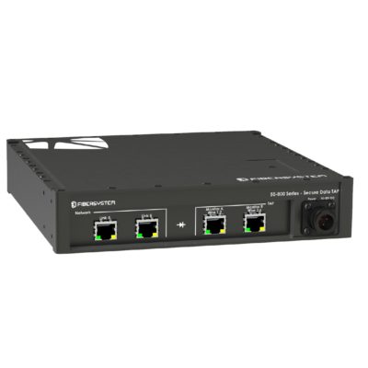
End Goal
Campus/ enterprise edge
Client
Switch
Server
Forwarding
Stream of packets
RTT Measurement Engine
Analytics and Mitigation
Packet headers
Stream of RTT samples
High-Speed Programmable Switch
Notes:
Introduce programmable data plane here

Slide 7
Continuous RTT Monitoring for TCP
Server
Trivial?
Retransmission ambiguity
Reordering ambiguity
Cumulative ACKs
Data (SEQ)
ACK
SEQ
High-speed switch
ACK
...
……
Continuous per-packet RTT
Client
eACK = SEQ# + len.
eACK == ACK#?
Idiosyncrasies of TCP traffic
Per-packet RTT
Notes:
Introduce programmable data plane here

Slide 8
The Balancing Act
Limitations of the programmable switch
Idiosyncrasies of TCP traffic
Notes:
Introduce programmable data plane here

Slide 9
Designing for Correctness
Challenges:
TCP retransmission ambiguity
TCP reordering ambiguity
Our solution: Store per-flow state
Detect retransmission, reordering
Eliminates erroneous RTT sampling
Reordering
Retransmission
Flow Sequence Number Space
ACK pkt.
Data pkt.
Already ACKed
Transmitted but not ACKed
Not seen yet
Already ACKed
Affected by retx., reordering
Transmitted but not ACKed
Not seen yet
No Sample!
Max. byte ACKed
Max. byte transmitted
Max. byte ACKed
Max. byte transmitted
Max. byte affected
Measurement Range = [Max. byte ACKed, Max. byte transmitted]
Measurement Range = [Max. byte affected, Max. byte transmitted]
Measurement Range = [Max. byte ACKed or affected, Max. byte transmitted]

Slide 10
Designing for Memory Efficiency
Cumulative ACKs
Large RTTs
Range Tracker
Packet Tracker
Range Tracker
Flow | M. Range
F1 | [100, 500]
Flow, eACK | Time
F1, 200 | 20
F1, 300 | 50
F1, 400 | 80
New Packet
Packet
RTT Sample
Protect against SYN flooding: Do not store handshake packets
DART: Data-plane Actionable Round-trip Times
Is evicted packet still valid?
Lazy Recirculation with Second Chance
Notes:
Introduce programmable data plane here

Slide 11
Implementation
Implemented in the Intel Tofino switch
~1800 lines of P4 code
Open-sourced
Notes:
Introduce programmable data plane here

Slide 12
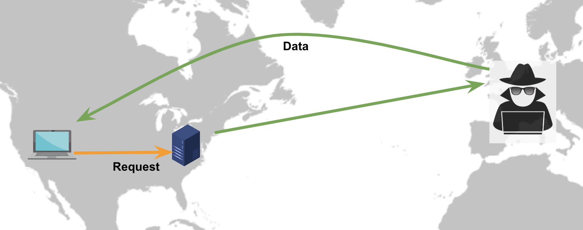
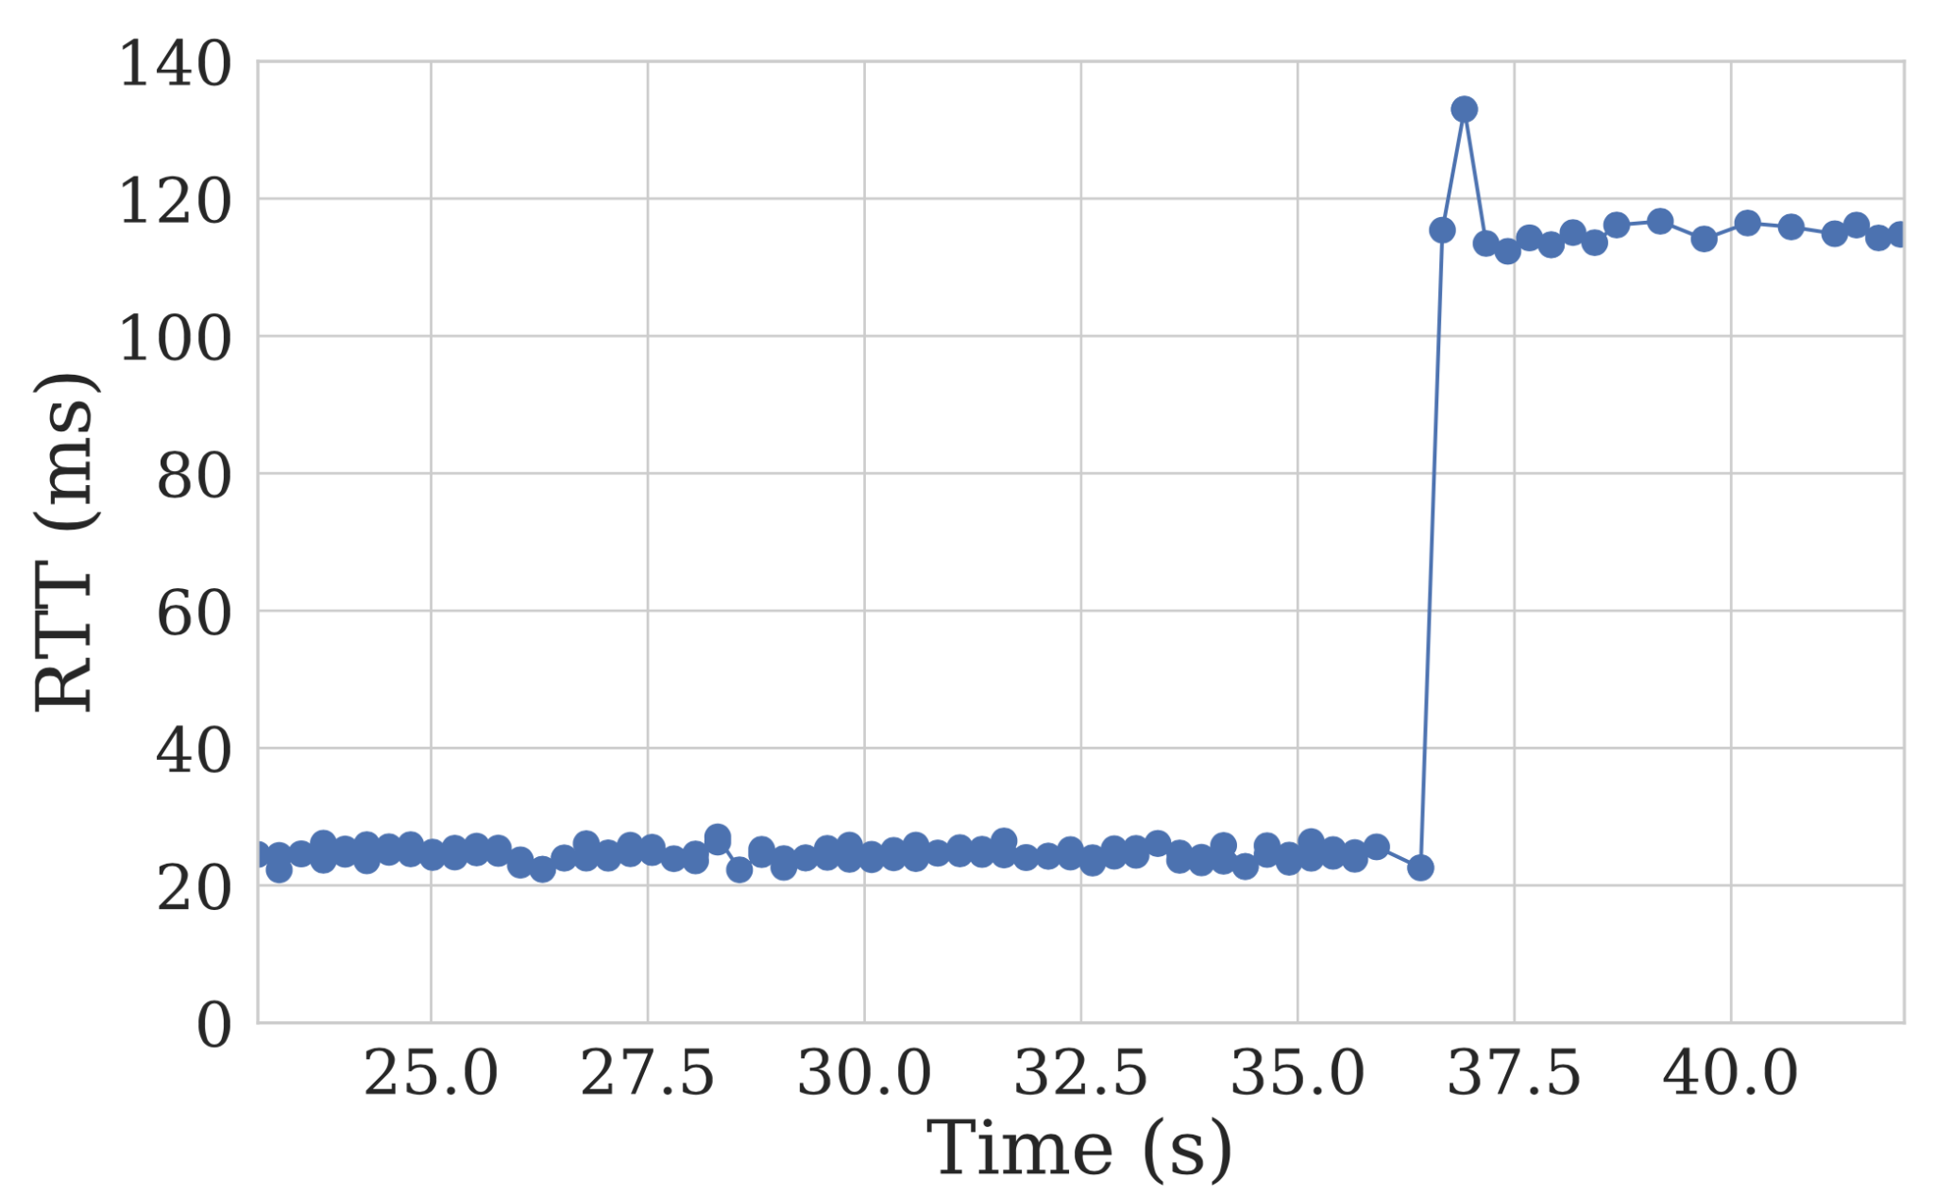
Detecting Interception Attacks in Real Time
Launch BGP interception attack using PEERING
Princeton Northeastern; adversary in
Detected within:
22 data packets
2 seconds!
Notes:
Introduce programmable data plane here

Slide 13
Simulation-Based Evaluation
vs.
tcptrace
Campus Packet Trace
DART in Python
RTT Samples
Takeaways:
Packet Tracker Memory | No. of Stages | Fraction of Samples | Recirculations
~24% of Tofino SRAM | 1 | ~99% | 10%
~24% of Tofino SRAM | 8 | ~100% | 16%
Notes:
Introduce programmable data plane here

Slide 14
Possibilities!
In-network use-cases
Continuous monitoring
Traffic engineering
Server selection
Generalizable design
Scalable “join” in the prog. data-plane
Diagnostic Tool
Ability to measure RTT “legs”
Fingerpointing-as-a- Service
8
Notes:
Introduce programmable data plane here

Slide 15
Thank You!
Code: https://github.com/Princeton-Cabernet/dart
Visit: https://p4campus.cs.princeton.edu/
Contact: satadal.sengupta@cs.princeton.edu
Cabernet
Notes:
Outline (data structure, evaluation + prototype, use-case/s)

