Slide 1
HotDASH:
Hotspot Aware Adaptive Video Streaming using Deep Reinforcement Learning
Satadal Sengupta
IIT Kharagpur, India
  Co-authors:
  Niloy Ganguly (IIT Kharagpur, India)
  Pradipta De (Georgia Southern University, USA)
  Sandip Chakraborty (IIT Kharagpur, India)

Slide 2
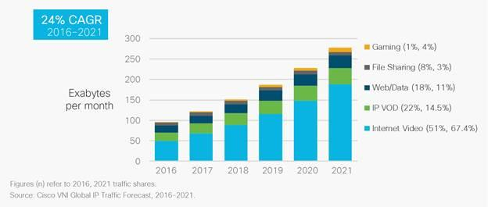
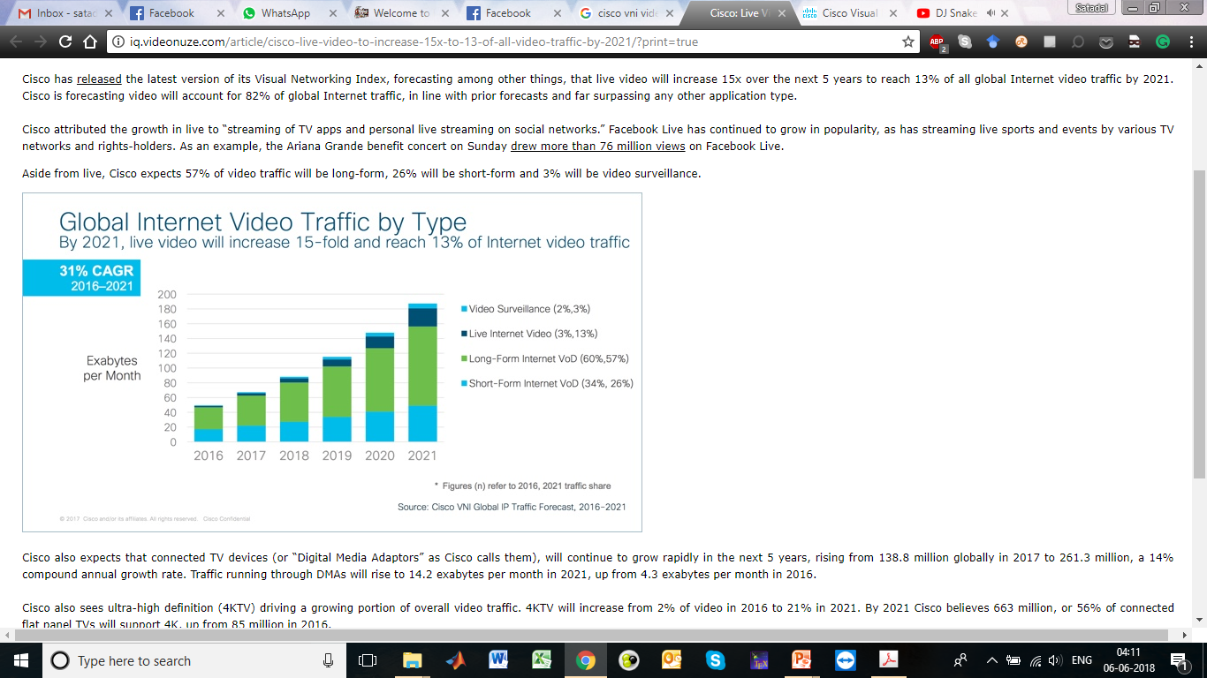
Why Bother About Video Streaming?
Global IP Traffic by Category (ExaBytes per month) [Source: Cisco VNI]
Global Internet Video Traffic (ExaBytes per month) [Source: Cisco VNI]
Efficient Video Streaming Strategies Essential

Slide 3

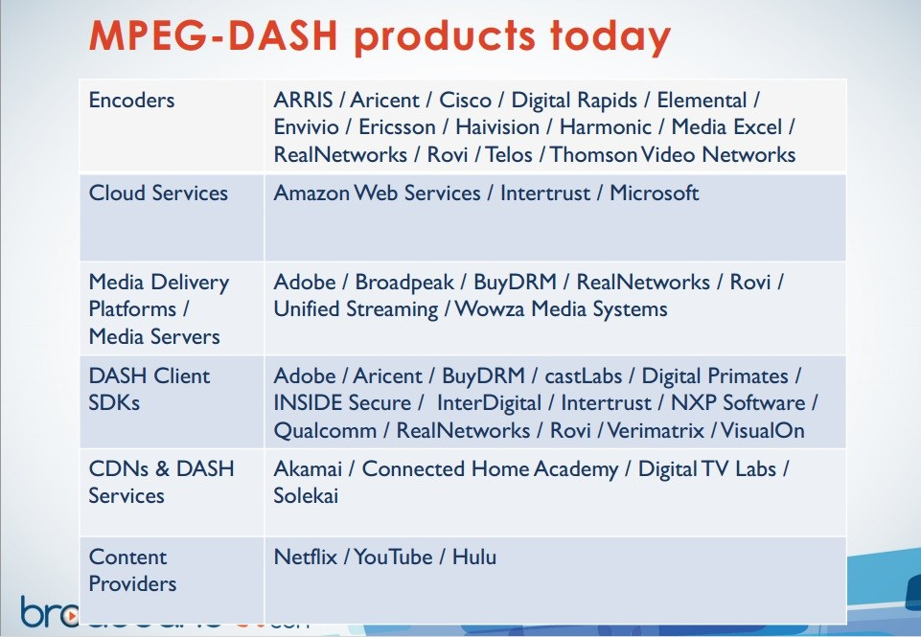



Adaptive Video Streaming to the Rescue?
Standardized as DASH (Dynamic Adaptive Streaming over HTTP)
Most Big Players Rely Upon DASH. But Why?

Slide 4

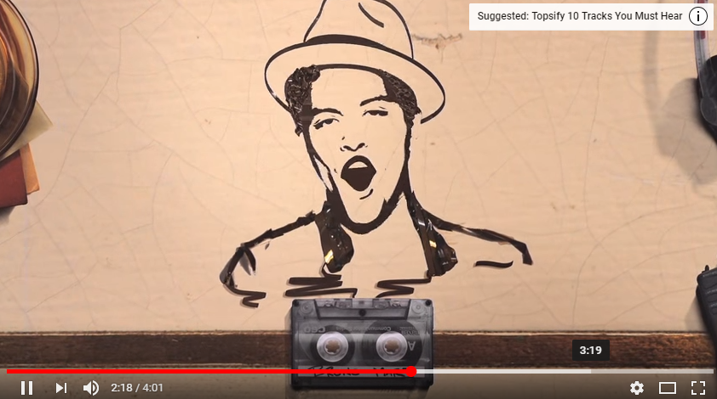

Bitrate Adaptation in DASH
Request:
next video chunk at bitrate R
Video Client
Response:
video chunk at bitrate R
Video Server
Client decides bitrate R of next chunk based on network conditions
720p
Adaptive Bitrate (ABR) Algorithms
480p
bitrate
360p
2 sec
2 sec
2 sec
Playback time
Resolution ~ Bitrate
Goal: Provide Best Possible Experience (QoE) to the Viewer

Slide 5
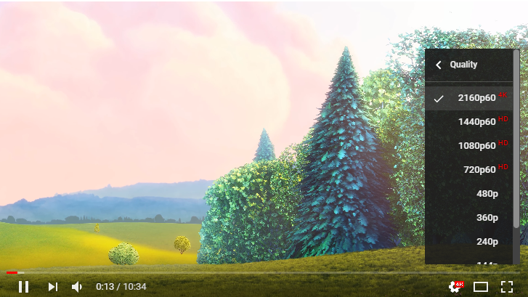



Existing Quality of Experience Metric
Bitrate/Resolution/Quality (maximize)
Rebuffering (minimize)
Lack of smoothness (minimize)
Conflicting Goals – Is Finding the Right Balance Easy?

Slide 6
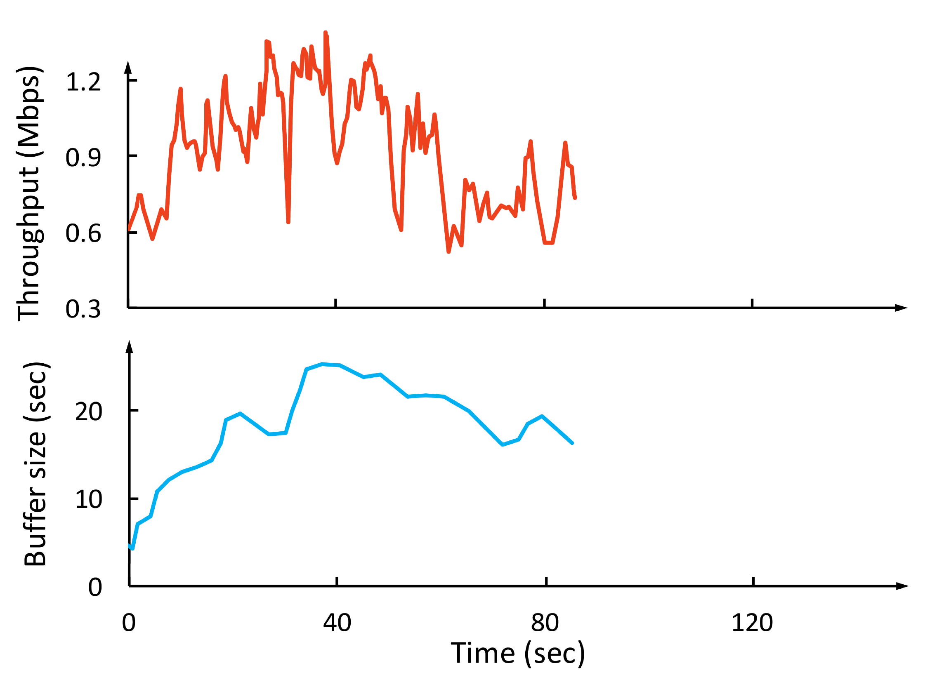
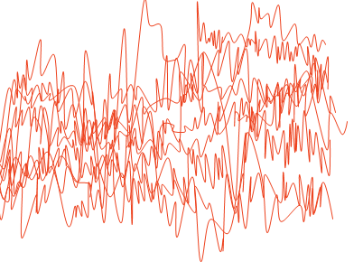
Why is Bitrate Adaptation Challenging?
Throughput
Throughput
Video Bitrate
(Mbps)
Network throughput is variable and uncertain
Video Bitrate
Conflicting QoE goals
Maximize Bitrate
Minimize Rebuffering
Maximize Smoothness
Time (sec)
Buffer size
(sec)
Cascading effects of decisions
Time (sec)
Existing Algorithms Address These Factors.
Do These Goals Accurately Represent User QoE?

Slide 7










Inadequacy of Existing QoE Metric
Bob
Disgruntled User, Even Though Adaptation Was Optimal!

Slide 8

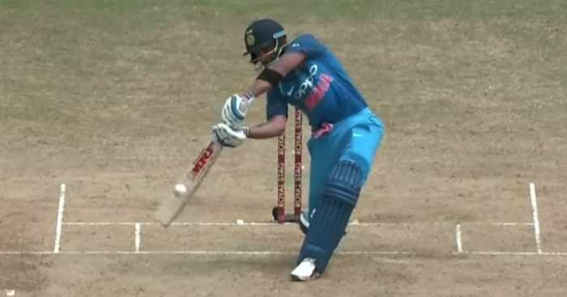


Personalization: Hotspot-Awareness
Hotspots: Temporal video segments associated with high user-interest
Rich body of studies on determining hotspots in a video – input
Objective: Bitrate adaptation strategy which is aware of hotspots
Time
Where Does That Leave Our QoE Metric?

Slide 9
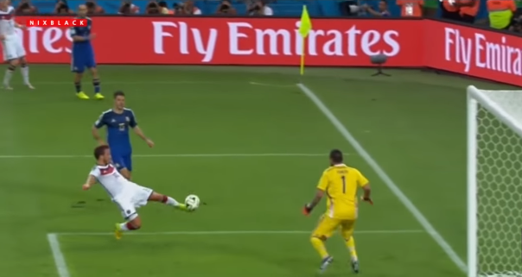
Quality of Experience: Our Proposed Metric
Bitrate/Resolution/Quality (maximize)
Rebuffering (minimize)
Smoothness (maximize)
Hotspot Bitrate (maximize)
Maximize Hotspot Bitrate, Without Compromising Existing Objectives

Slide 10
Problem Statement
Given a set of hotspot segments for a video, achieve bitrate adaptation for video streaming such that:
(1) Hotspots are streamed at the highest bitrate possible under current network conditions,
(2) Without compromising on overall bitrate, rebuffering, and smoothness objectives,
(3) Thus making optimal use of available network bandwidth.
How Can We Ensure High Hotspot Bitrate, Even If Bandwidth Declines Just Before A Hotspot Segment Is Downloaded?

Slide 11
Solution Approach: Opportunistic Prefetch
Prefetch: Download hotspot segments early, when bandwidth is higher, and there is sufficient content in buffer
Research Challenge: How to determine the right opportunities for prefetching hotspot chunks?
Solution Approach: Learn through experience, i.e., employ Reinforcement Learning
Technical Challenge: Implementation of prefetch functionality in DASH client players
An End-to-end System Which Addresses Both Challenges,
Enables Hotspot-aware Video Streaming

Slide 12
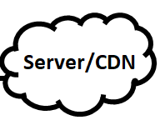
The Proposed System: HotDASH
Playback State Information
HotDASH Decision Engine
hotdash.js
Bitrate & Prefetch
Decisions
What Information Does the Decision Engine Require?

Slide 13
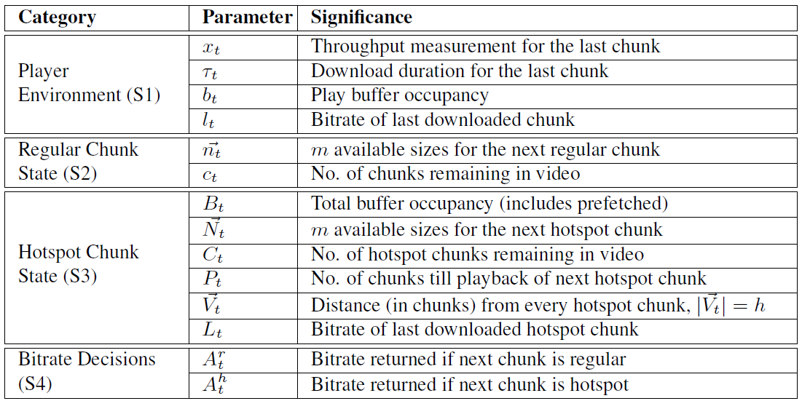
HotDASH Decision Engine: Input State Parameters
Bitrate Decisions are Required as Inputs for the Prefetch Decision!

Slide 14
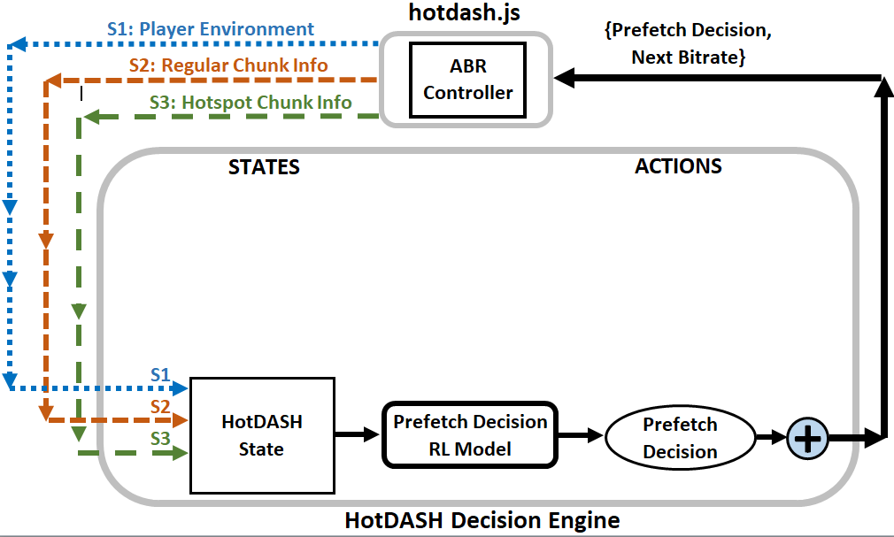
HotDASH Decision Engine: Cascaded RL Design

Slide 15

HotDASH Decision Engine: Cascaded RL Design

Slide 16
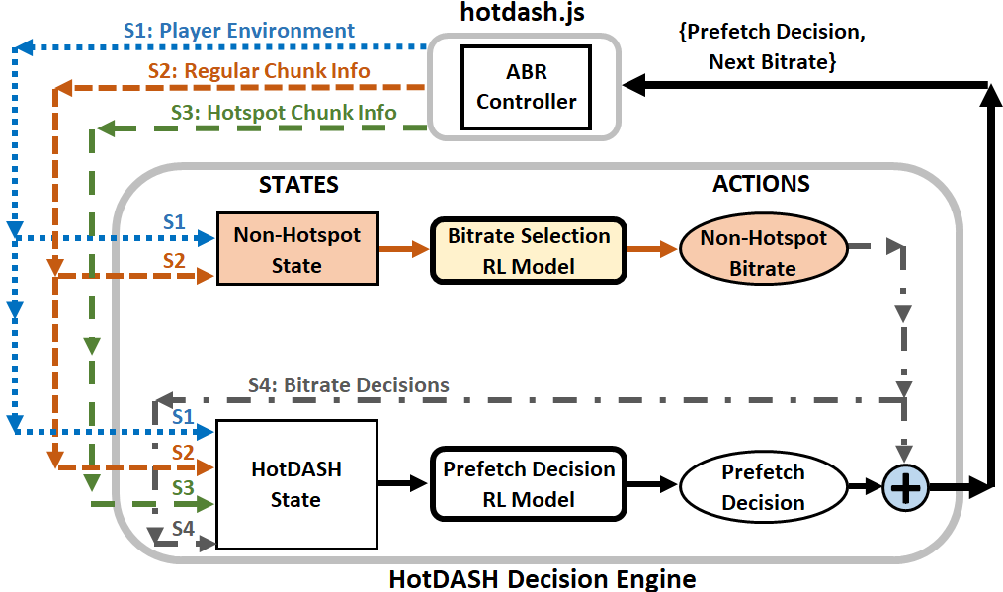
HotDASH Decision Engine: Cascaded RL Design

Slide 17
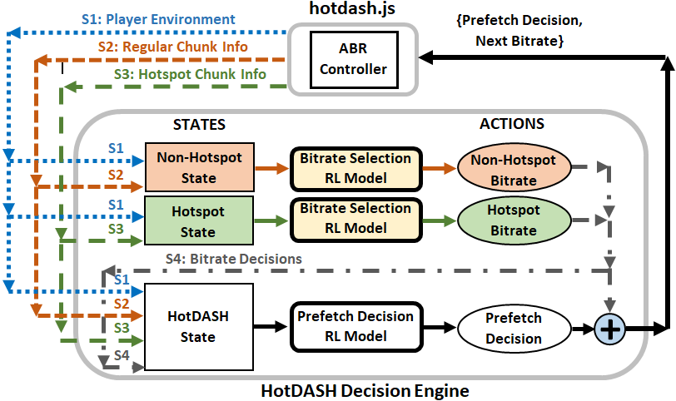
HotDASH Decision Engine: Cascaded RL Design
Cascaded RL Structure Leverages Knowledge of System State Better

Slide 18


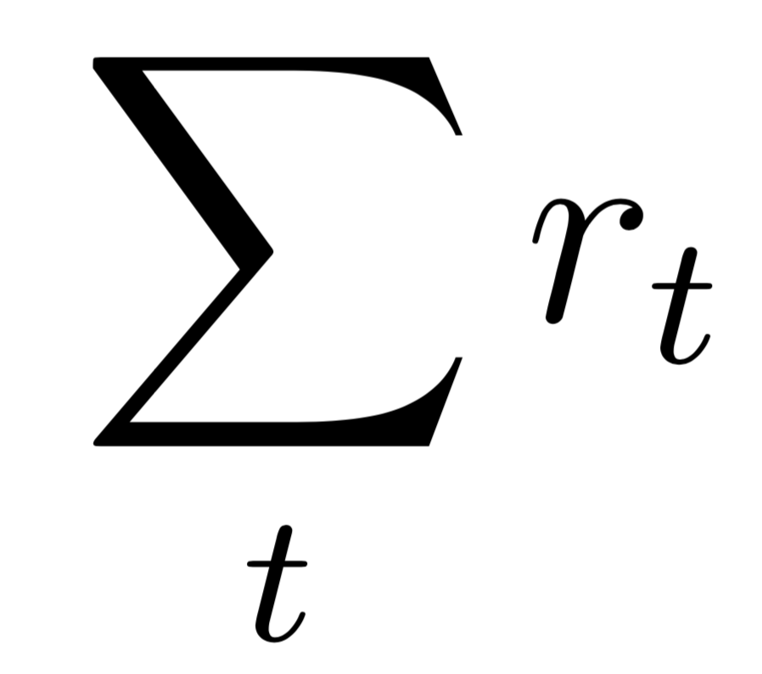

Reinforcement Learning
Reward
Agent
Environment
Goal: Maximize the Cumulative Reward
Take action
Observe state
Training Algorithm: A3C (Actor-Critic Network, Policy-Gradient Method) [Google DeepMind, ICML’16]
We Adopt A3C for Both Bitrate Selection and Prefetch Decision

Slide 19



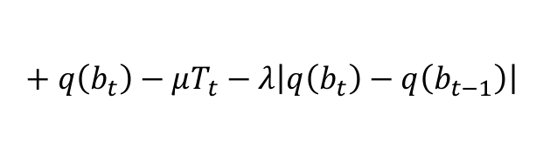
Bitrate Selection RL Model
Reward r_{t}
State
Agent
$$+ q\left(b_{t}\right)−μT_{t}−λ\left|q\left(b_{t}\right)−q\left(b_{t−1}\right)\right|$$
+ (bitrate) - (rebuffering) - (smoothness)
240P
Action a_{t}
360P
Action
720P
720P
1080P
We Leverage Pensieve [SIGCOMM’17]
for the Bitrate Selection Model

Slide 20
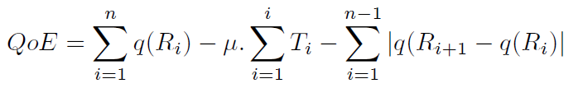
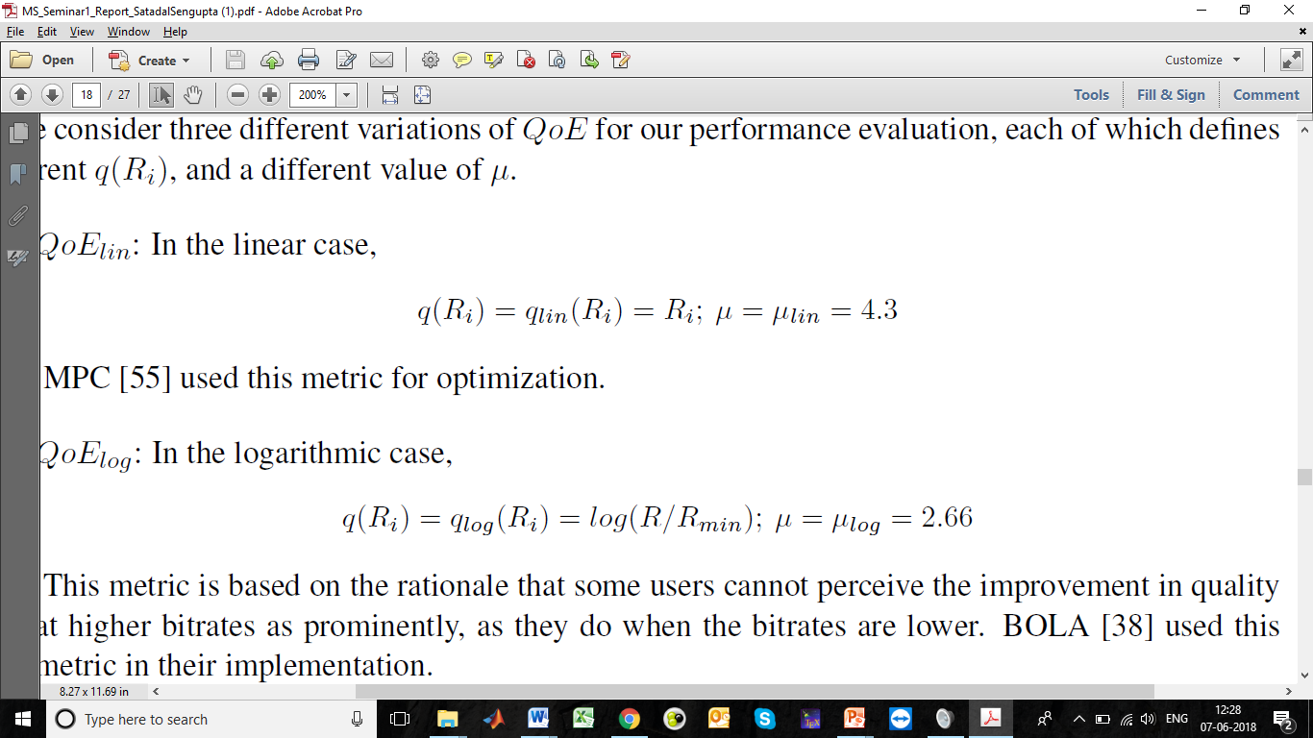
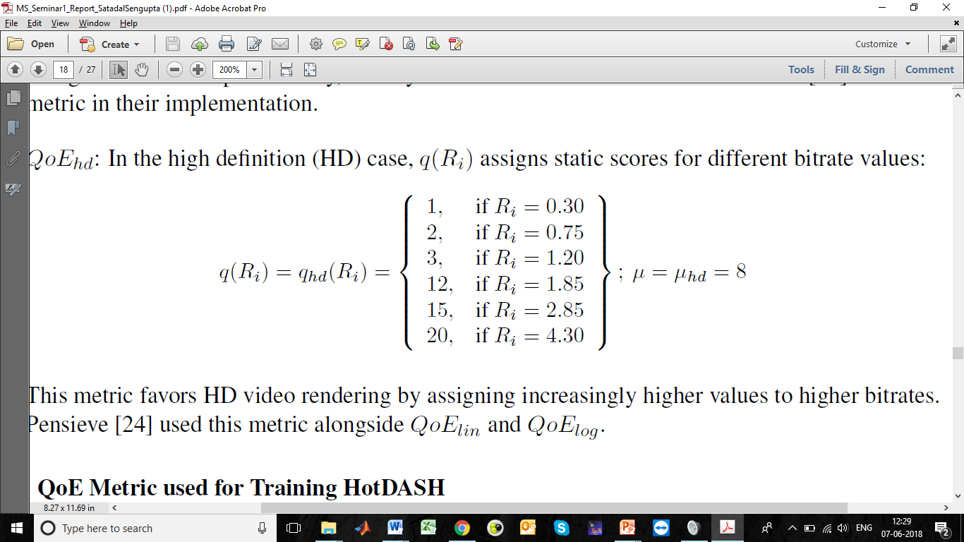
Prefetch Decision RL Model: Reward
Existing Reward Metric (representative of QoE)
Linear:
Logarithmic:
HD:

Slide 21
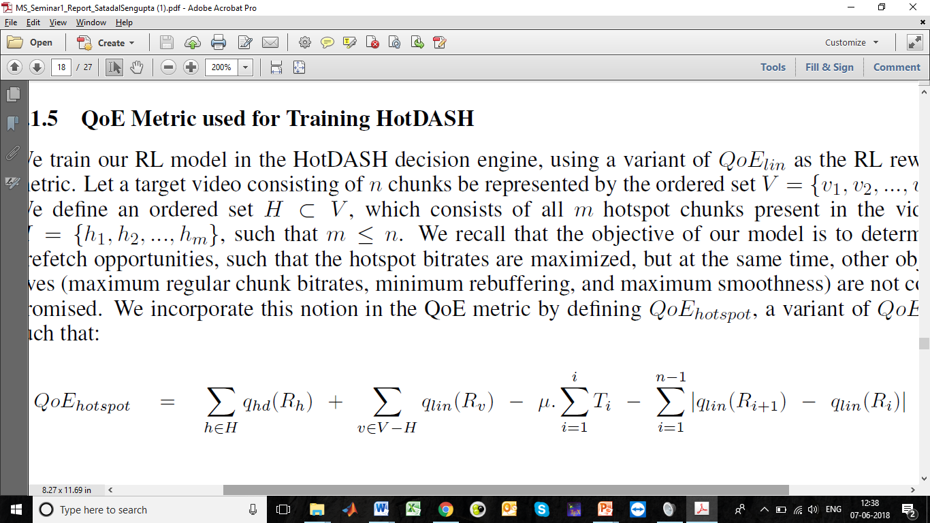
Prefetch Decision RL Model: Reward
Existing Reward Metric (representative of QoE)
Reward Metric (used for training the Prefetch Decision Engine):
Captures Intent to Balance Hotspot Bitrate & Other Parameters
How Does the Client Execute Prefetch Decisions?

Slide 22
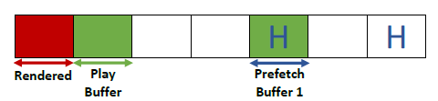
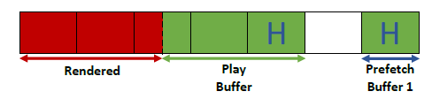
Building a Prefetch-Enabled DASH Client
hotdash.js – Based on an open-source DASH player dash.js, maintained by the DASH Industry Forum
Defined separate Prefetch Buffers and a Play Buffer
Enabled On-demand Chunk and Buffer Reconciliation
The System is Now Prefetch-Enabled. How Do We Evaluate It?

Slide 23
Evaluation Methodology
Trace Driven Evaluation
Dataset: Two datasets, each dataset consists of 1000 traces, each trace 320 seconds.
Video: 193 seconds. encoded at bitrates: {300, 750, 1200, 1850, 2850, 4300} kbps.
Video player: Google Chrome browser
Video server: Apache server
Parallel Training: Using 1 master agent and 16 slave agents on Tensorflow
Hotspot Selection and Generalization
No. of Hotspots: 10% of video (amounts to 12mins for a 2hr video).
Training: Fixed combination of hotspots.
Testing: 100 carefully chosen combinations of hotspots, to test generalizability.
Exhaustiveness: Ensured using WSP space-filling algorithm [Chemometrics’12].
How Does HotDASH Perform?

Slide 24
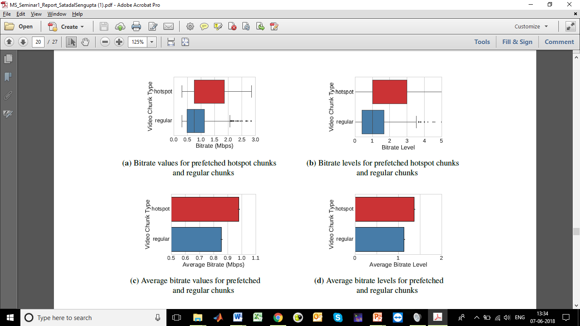
Hotspot Bitrate Improvement
HotDASH Prefetched Hotspots at 14.31% Better Bitrate (on Avg.)

Slide 25
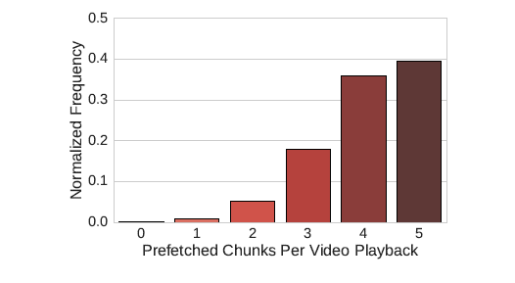
Prefetch Decisions
HotDASH Utilizes Prefetch Opportunities Aggressively
Prefetches All 5 Hotspots Around 40% of the Time
However, Bitrate Improvements Demonstrates
Opportune Decision-Making

Slide 26
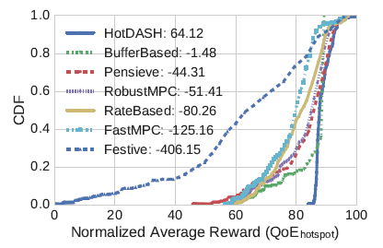
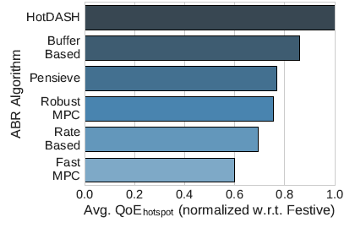
QoE Improvement Over Baselines
HotDASH Outperforms Best-Performing Baseline
Buffer-Based By 16.2%

Slide 27
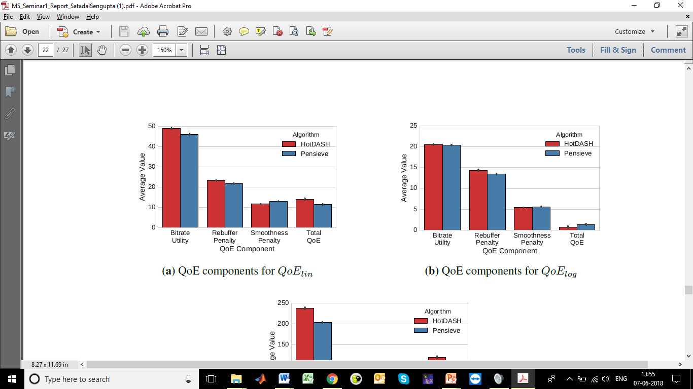
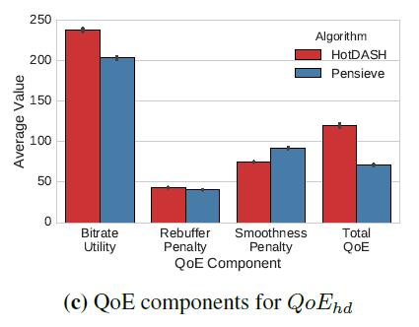
Overall QoE: HotDASH vs. Pensieve
Performs Best in HD Case, High Bitrate Comes at Cost of Rebuffering

Slide 28
Conclusion
Proposed Hotspot-Aware Adaptive Video Streaming System HotDASH
Uses Opportune Prefetch to Improve Bitrate for Hotspot Segments
Optimal Prefetch and Bitrate Decisions Using Reinforcement Learning
Achieves Better Performance Than All Baselines, Outperforming the Best One By 16.2% In Terms of Average Bitrate
Future Questions
Can we generalize across videos and varying no. of hotspots?
Can we leverage our system to learn user preferences from their viewing habits?
Will a joint learning mechanism help improve performance?

Slide 29

Follow my work:
https://satadalsengupta.github.io
Contact me:
satadal.sengupta@iitkgp.ac.in
I belong to the CNeRG group. Learn more about our work on interesting problems across CS domains:
http://www.cnergres.iitkgp.ac.in
https://www.facebook.com/iitkgpcnerg
https://twitter.com/cnerg

Slide 30
Backup

Slide 31
Related Work: Determing QoE
Hybrid: combined objective (e.g. PSNR) and subjective scores (e.g. MOS)
  Piamrat et al. [ITNG’09], Mok et al. [IM’11]
Role of User Profiles: differences due to gender, freq. of watching, etc.
  Song et al. [MM’11], Zhu et al. [MM’16]
Role of Streaming Conditions: device type, resolution, cable vs. wireless
  Dobrian et al. [SIGCOMM’11], Krishnan et al. [TON’13], Balachandran et al. [SIGCOMM’13], Duanmu et al. [MM’17]
Role of Player: comparative study of different DASH players
  Stohr et al. [MM’17]
QoE Varies Based on User Profile – Need for Personalization

Slide 32
Related Work: Interesting Segment Selection
Scene Segregation: determine frames marking beginning of scene
  Zhang et al. [US Patent’97]
Content Based: determine important segments based on audio and video semantics
  Uchihashi et al. [MM’99], Merialdo et al. [CBMIR’01], De et al. [SIBGRAPI’08]
User Attention Based: leverages user reactions to different scenes
  Ma et al. [MM’02], Zhai et al. [MM’06], Peng et al. [IEEE Tx. Multimedia’11]
Supervised: learn using human annotated datasets
  Gong et al. [NIPS’14], Jin et al. [MM’17], Volokotin et al. [MM’17]
These Approaches May Be Leveraged for Hotspot Determination

Slide 33
Related Work: Adaptive Bitrate Algorithms
Rate-based: pick bitrate based on predicted throughput
  FESTIVE [CoNEXT’12], PANDA [JSAC’14], CS2P [SIGCOMM’16]
Buffer-based: pick bitrate based on buffer occupancy
  BBA [SIGCOMM’14], BOLA [INFOCOM’16]
Hybrid: use both throughput prediction & buffer occupancy
  PBA [HotMobile’15]
QoE-metric based: optimization problem to maximize QoE metric
  MPC [SIGCOMM’15], Pensieve [SIGCOMM’17]
Many of These Algorithms Serve as Baselines

Slide 34
Related Work: QoE-Aware Video Prep. and Delivery
Optimized Delivery: e.g., SDN for scalability, push-based for live video
  Huysegems et al. [MM’15], Bentaleb et al. [MM’16]
Streaming on Mobile: diff. in perception, power & resource constraints
  DASH2M [MM’16], Wu et al. [MM’17]
Interest-Oriented Video: spatial and temporal considerations
  Zhang et al. [MM’14], Choi et al. [MM’16], Yang et al. [MM’17]
Prefetching: for branched videos and next-in-playlist videos
  Krishnamoorthi et al. [MM’14, MM’15]
Augmentations for Better Overall Experience

Slide 35
Bitrate Selection RL Model
Reward
State
Agent
Environment
Action

Slide 36
Bitrate Selection RL Model
Reward
Reward r_{t}
State
Agent
$$+ q\left(b_{t}\right)−μT_{t}−λ\left|q\left(b_{t}\right)−q\left(b_{t−1}\right)\right|$$
+ (bitrate) - (rebuffering) - (smoothness)
Action

Slide 37
Bitrate Selection RL Model
Reward
Reward r_{t}
State
Agent
$$+ q\left(b_{t}\right)−μT_{t}−λ\left|q\left(b_{t}\right)−q\left(b_{t−1}\right)\right|$$
+ (bitrate) - (rebuffering) - (smoothness)
Action

Slide 38
Bitrate Selection RL Model
Reward
Reward r_{t}
State
Agent
$$+ q\left(b_{t}\right)−μT_{t}−λ\left|q\left(b_{t}\right)−q\left(b_{t−1}\right)\right|$$
+ (bitrate) - (rebuffering) - (smoothness)
240P
Action a_{t}
360P
Action
720P
720P
1080P

Slide 39
Bitrate Selection RL Model
Reward r_{t}
State
Agent
$$+ q\left(b_{t}\right)−μT_{t}−λ\left|q\left(b_{t}\right)−q\left(b_{t−1}\right)\right|$$
+ (bitrate) - (rebuffering) - (smoothness)
240P
Action a_{t}
360P
Action
720P
720P
1080P

Slide 40
Bitrate Selection RL Model
Reward r_{t}
State
Agent
$$+ q\left(b_{t}\right)−μT_{t}−λ\left|q\left(b_{t}\right)−q\left(b_{t−1}\right)\right|$$
+ (bitrate) - (rebuffering) - (smoothness)
240P
Action a_{t}
360P
Action
720P
720P
1080P
We Leverage Pensieve [SIGCOMM’17]
for the Bitrate Selection Model

Slide 41
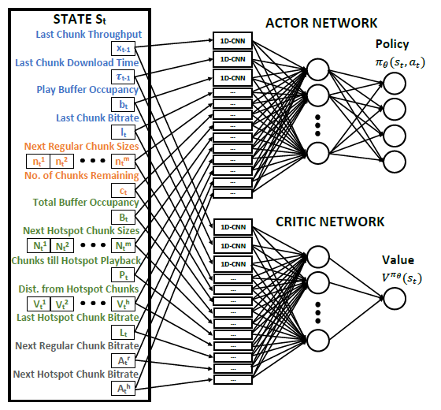
Prefetch Decision RL Model: Network
Actor Network:
Generates policy and refines it at each epoch, based on cumulative reward
Critic Network:
Refines further by comparing current reward with best reward for the current state; acts as a local baseline
Client Player Still Needs to Execute Prefetch Decisions

