Slide 1
MoViDiff Enabling Service Differentiation for Mobile Video Apps Speaker: Satadal Sengupta Indian Institute of Technology Kharagpur, India
Co-authors:
Vinay Kumar Yadav (IIT Patna) Niloy Ganguly (IIT Kharagpur)
Yash Saraf (IIT BHU) Sandip Chakraborty (IIT Kharagpur)
Harshit Gupta (IIT Kharagpur) Pradipta De (Georgia Southern Univ.)

Slide 2
What is Service Differentiation?
Bandwidth sharing among different classes of traffic
Sharing based on context and user-requirement
Example: DiffServ Architecture
Enables Fine-Grained Bandwidth Control

Slide 3
Why Mobile Video Apps?
Video most data-consuming service on mobile
Expected to rise to 3/4th of all mobile data traffic by 2020 (Cisco Visual Networking Index Report)
Bandwidth control on video apps most relevant
Notes:
CAGR - Compound Annual Growth Rate

Slide 4
Types of Mobile Video Apps
Streaming Video Apps
Data-hogging apps
Pre-recorded
Entertainment
Can withstand bandwidth drop
Interactive Video Apps
Consume lesser data
Interactions/meetings
Sufficient bandwidth vital
Easily overshadowed by streaming video apps
Interactive apps more bandwidth-sensitive than Streaming apps
Star India
Notes:
CAGR - Compound Annual Growth Rate

Slide 5
Service Differentiation in Mobile Video Apps – Where is it Useful?
Multiple devices, playing different types of videos, connected to single router (or tethered to a phone) – gateway device
Sharing of fixed (low) bandwidth
Some such scenarios:
Households
Academic/Enterprise Set-ups
Personal mobile hubs
Goal: Acceptable quality at all connected end-devices

Slide 6
Personal Mobile Hub – Use-case
Same user on different video apps on different devices
Tethered to the same hotspot, served by a Gateway Device
Examples: Remote tech/medical help, simulated movie dates
Can different bandwidths be allocated to the devices?

Slide 7
The Problem Statement
In the presence of simultaneous traffic flows from a streaming video app and an interactive video app,
in the presence/absence of background non-video traffic,
allocate bandwidth at the gateway device such that experiences at both apps remain satisfactory

Slide 8
Core Challenges
Core Research Challenge:
Question: How to classify traffic originating from different apps?
Approach: Attribute every single data packet to its origin app
Core Implementation Challenge:
Question: If the origin of traffic is known, how to achieve differentiation in terms of service?
Approach: Intercept a packet, schedule it according to desired Quality of Service (QoS)
Resolving both challenges leads to the overall solution

Slide 9
Traffic Classification in Mobile Apps: Why not a Solved Problem?
Traffic classification relies on identifying unique signatures
Common signatures used to identify desktop applications:
Port number used by an application
Host address of the server
Other protocol-specific identifiers in the network packets
Unique situation in case of mobile apps:
Port-based identification invalidated since most traffic tunnelled over HTTP
Inspection for protocol-specific identifiers not possible on encrypted packets
Introduction of protocols like QUIC, which allow for end-to-end encryption
Traffic Classification in Mobile Apps a Non-Trivial Problem

Slide 10
Traffic Classification: Related Work
Traffic identification based on deep packet inspection (DPI)
HTTP user-agent field (Xu et. al. – IMC 2011)
In-app advertisements (Tongaonkar et. al. – PAM 2013)
Signature strings in packet content (Yao et. al. – MobiCom 2015)
Limitation: Ill-suited for encrypted traffic – involves peering inside the packet
Identification of flow patterns in video applications
Patterns in Skype traffic (Yuan et. al. – ICNC 2014, Jesudasan et. al. – CAIA 2010)
Youtube on PC (Ameigeiras et. al. – Tranx. on Emerging Telecommunications Technologies 2012, Ramos-Munos – IEEE Wireless Communications 2014)
Limitation: Proposed for web versions – we build on these studies
Need for a classification technique for encrypted mobile app traffic

Slide 11
Experimental In-Laboratory Setup
Testbed Setup
Trace Collection Scenarios
Pre-processing: Flow Segregation (based on 5-tuples)

Slide 12
Traffic Classification: Observations
Traffic distribution for different kinds of apps
Distinct patterns for different kinds of apps

Slide 13
Traffic Classification: Packet-level Features
Interesting packet-level features – from observations
Packet-size (PS)
Inter-arrival Time (IAT)
Bandwidth (BW)
Why are these features useful for classification?

Slide 14
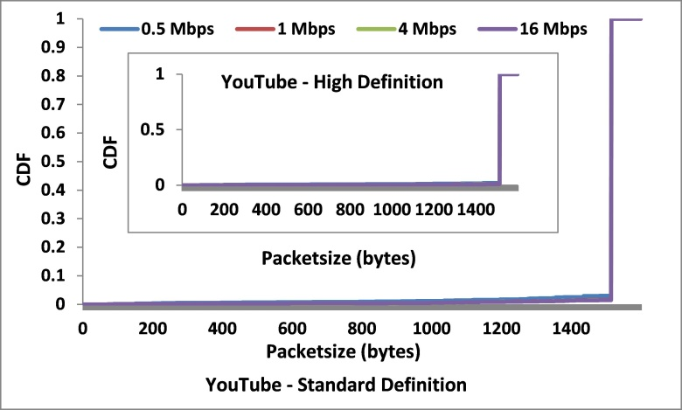
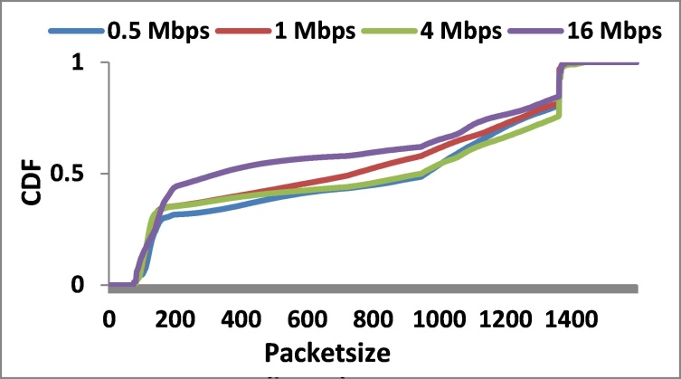
Packet-size Distribution
YouTube Skype
Packet-size saturates at maximum transmission unit (MTU) for YouTube, distributed over lower values for Skype

Slide 15
Packet-size Distribution: In Summary
Streaming Video Apps – Packet-size saturates at a fixed value, which is the max. transmission unit (MTU) for transport layer, for Wi-Fi
Streaming Video Apps – Packet-size distribution shows (almost) no variation with video resolution
Interactive Video Apps – Significant variation over a range, sometimes with bandwidth
Packet-size distribution consistent for individual apps, but marked difference between streaming and interactive traffic
Packet-size can be a classification feature

Slide 16
Inter Arrival Time (IAT) Distribution
YouTube
Skype
Sharp change in IAT at particular values for YouTube, gradual change for Skype

Slide 17
IAT Distribution: In Summary
Sharp changes in IAT value for streaming traffic, gradual change for interactive traffic
Behaviour can be traced back to bursty pattern of streaming traffic
IAT values generally low for interactive traffic; however, chance of confusion with inter-burst IATs of streaming traffic
Inter-Packet Timing Average (IPTA) – moving average, serves as a better classification parameter
Variation of values with bandwidth – bandwidth is a potential feature
IPTA and Bandwidth can be classification features

Slide 18
System Architecture
Identify app launch from handshake packet
Machine learning based traffic classifier
Features – subset of (packet-size, IPTA, bandwidth)
Implemented pymovidiff
Based on NFQueue lib.
Priority parameter λ
Implementation – in-depth

Slide 19
System Architecture: App Identifier
Inspect handshake packets exchanged when a new network-based app is launched
SSL server certificate unique for an app
One-time low-overhead process to identify launch of an app
Detecting app launch does not ensure that each packet is uniquely identified
How to Ensure Packet-level Identification?

Slide 20
System Architecture: Flow Differentiator
Data-Control Classifier
Control Packets – ARP, DNS, IGMP, ICMP, NTP, DB-LSP-DISC (Dropbox Lan Sync Protocol), etc.
Control packets do not carry video content – removal ensures better classification accuracy
SVM with packet-size as the lone feature – control packets are typically much smaller than data packets
Avg. accuracy of 99% achieved
Weeding out Control Packets

Slide 21
System Architecture: Flow Differentiator
Flow Classifier
Takes a single data packet as input, and classifies it into belonging to one of the target apps (streaming/interactive), or background traffic
Classification based on a subset of the following features:
Packet-size, IPTA, Bandwidth
Binary SVM (absence of background traffic) Multi-class SVM (presence of background traffic)
Packet-level Classification

Slide 22
System Architecture: Service Differentiator
Implemented Python module called pymovidiff
Based on the NetFilterQueue (NFQueue) module for packet interception and scheduling
Pymovidiff works with a producer thread and a consumer thread, scheduling packets based on user priority parameter λ
Packet Scheduling ensuring Service Differentiation

Slide 23
Evaluation
MoViDiff as a Service Differentiator
Bandwidth allocation
Impact on video quality
MoViDiff as a Traffic Classifier
Absence of background traffic
Presence of background traffic

Slide 24
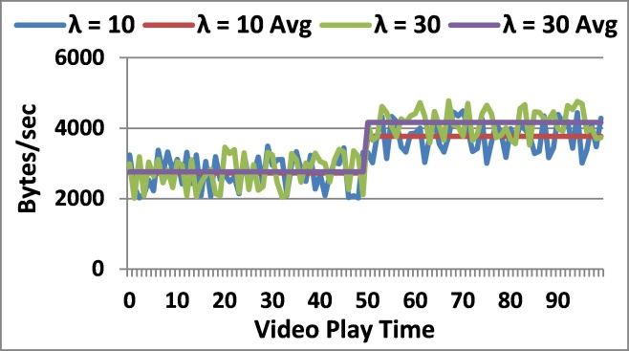
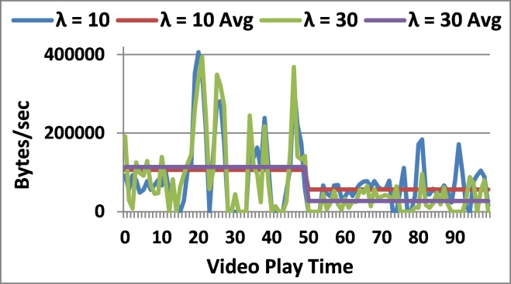
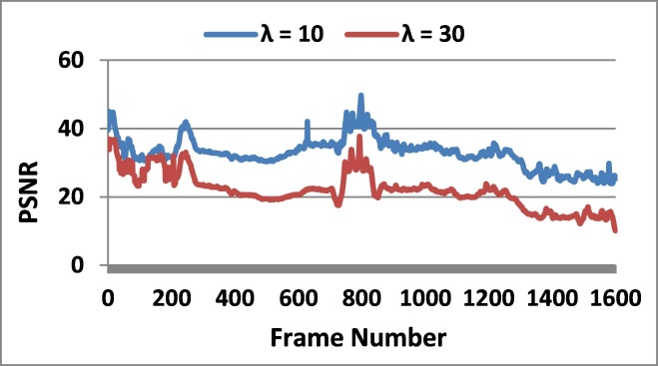
Evaluation
MoViDiff performance as a Service Differentiator
The bandwidth allocation of preferred application Skype increases while for YouTube it decreases
Despite bandwidth allocation, the YouTube stream is acceptable as shown by the PSNR (Peak-Signal-to-Noise-Ratio) – Result of adaptive HTTP
MoViDiff works successfully as a Service Differentiator

Slide 25
Evaluation
MoViDiff performance in Absence of Background Traffic
Packet-Size as the Only Feature
Good Classification due to distinct Packet-sizes

Slide 26
Evaluation
MoViDiff performance in Presence of Background Traffic
Packet-Size as the Only Feature
Good Accuracy for YouTube & HotStar Poor Classification for TED – Similar PS

Slide 27
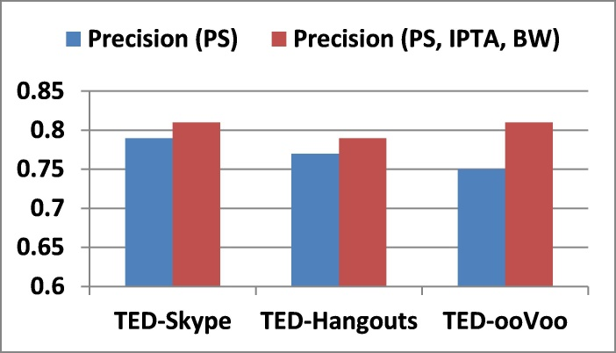
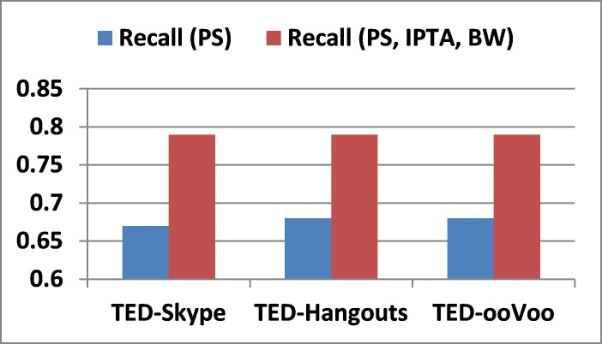
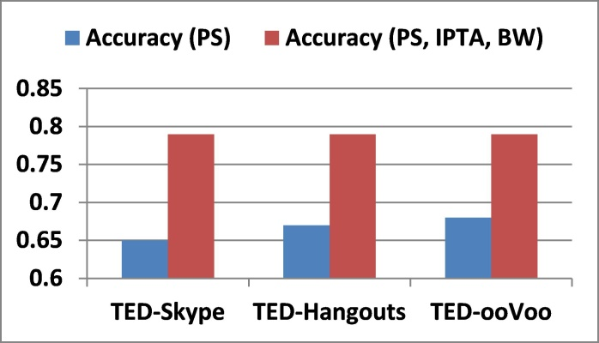
Evaluation
MoViDiff performance in Presence of Background Traffic
One Feature vs. Multiple Features for TED
Average Precision Average Recall Average Accuracy
Classification Performance improves for TED

Slide 28
Conclusion
Service differentiation system for Mobile Video Apps
Based on a Traffic Classification core
Traffic Classification based on Packet-level features
Performance improves on adding additional features for poorly-performing cases

Slide 29
Work in Progress: Can we do Better?
Why? Near 100% accuracy desired for classification in real-time.
Identify additional features for better classification
Bit-pattern similarity among encrypted packet payloads
Hypothesis: Payloads encrypted with same algorithm and key should have high similarity, especially towards the beginning
Similarity Measures: e.g., K-L Divergence on FFT of bit-streams

Slide 30
Thank You! Questions?

Slide 31
Backup

Slide 32
Is the Use-Case Practical?
Prevalent in many scenarios:
Remote medical help – Remote tech support
Long-distance couple watching a movie together
Applications which combine chatting and streaming experience
Rabbit (https://www.rabb.it/)
Practical, and increasingly prevalent!

Slide 33
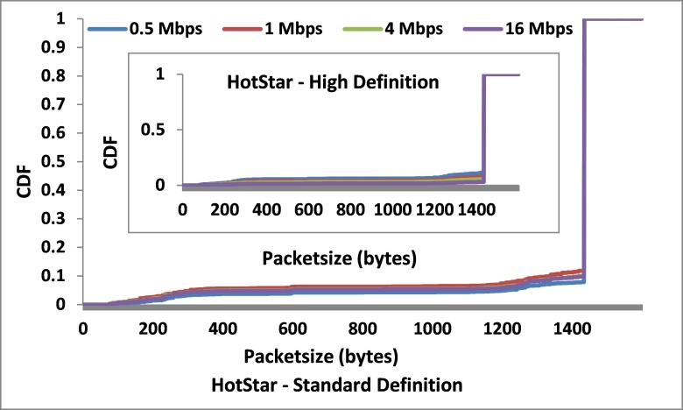
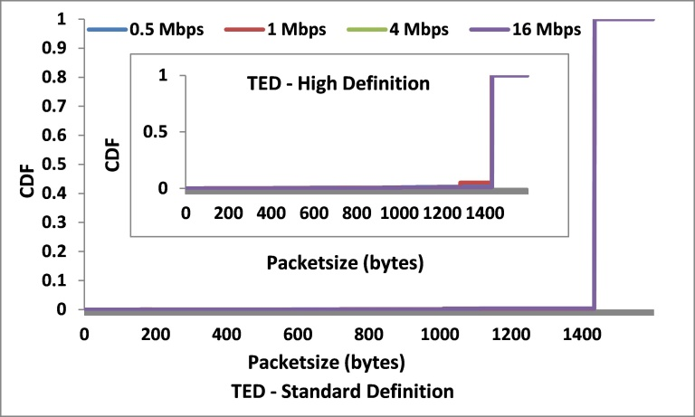
Packet-size Distribution: Streaming Video Apps
Packet-size saturates at maximum transmission unit (MTU)

Slide 34
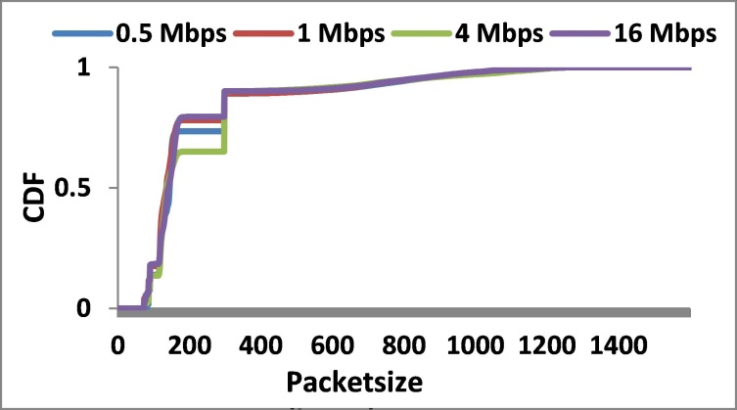
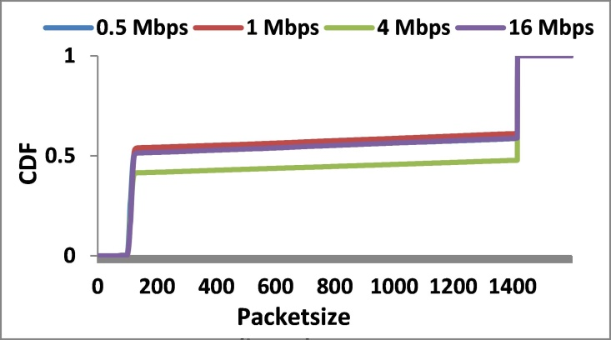
Packet-size Distribution: Interactive Video Apps
Skype Google Hangouts
ooVoo
Packet-size varies a lot, sometimes with bandwidth

Slide 35
IAT Distribution: Streaming Video Apps
Sharp change in IAT at a particular value

Slide 36
IAT Distribution: Interactive Video Apps
Gradual change in IAT

Slide 37
Evaluation
MoViDiff performance as a Traffic Classifier
SVM module (scikit-learn, C=1, RBF kernel) – 70/30% training-testing
Performance of Data-Control Classifier
Near-Perfect Data-Control Classification

Slide 38
Evaluation
MoViDiff performance for a Video App vs. Mixed Traffic from Background Apps
Packet-Size as the Only Feature
Good for Interactive, Poor for Streaming (except YouTube)

Slide 39
Evaluation
MoViDiff performance in Presence of Background Traffic
Packet-Size, IPTA, and Bandwidth as Features
Classification Performance improves for TED

