Slide 1
Leveraging Facebook’s Free Basics Engine for Web Service Deployment in Developing Regions
Siddharth Singh, Vedant Nanda, Rijurekha Sen, Satadal Sengupta, Ponnurangam Kumaraguru, Krishna P. Gummadi

Slide 2
Leveraging Facebook’s Free Basics Engine for Web Service Deployment in Developing Regions
Siddharth Singh, Vedant Nanda, Rijurekha Sen, Satadal Sengupta, Ponnurangam Kumaraguru, Krishna P. Gummadi
Presented by: Zaid Ahmed
(who helped with many of the experiments here and is a co-author in two related papers)

Slide 3
Facebook’s Free Basics – what is it?

Slide 4
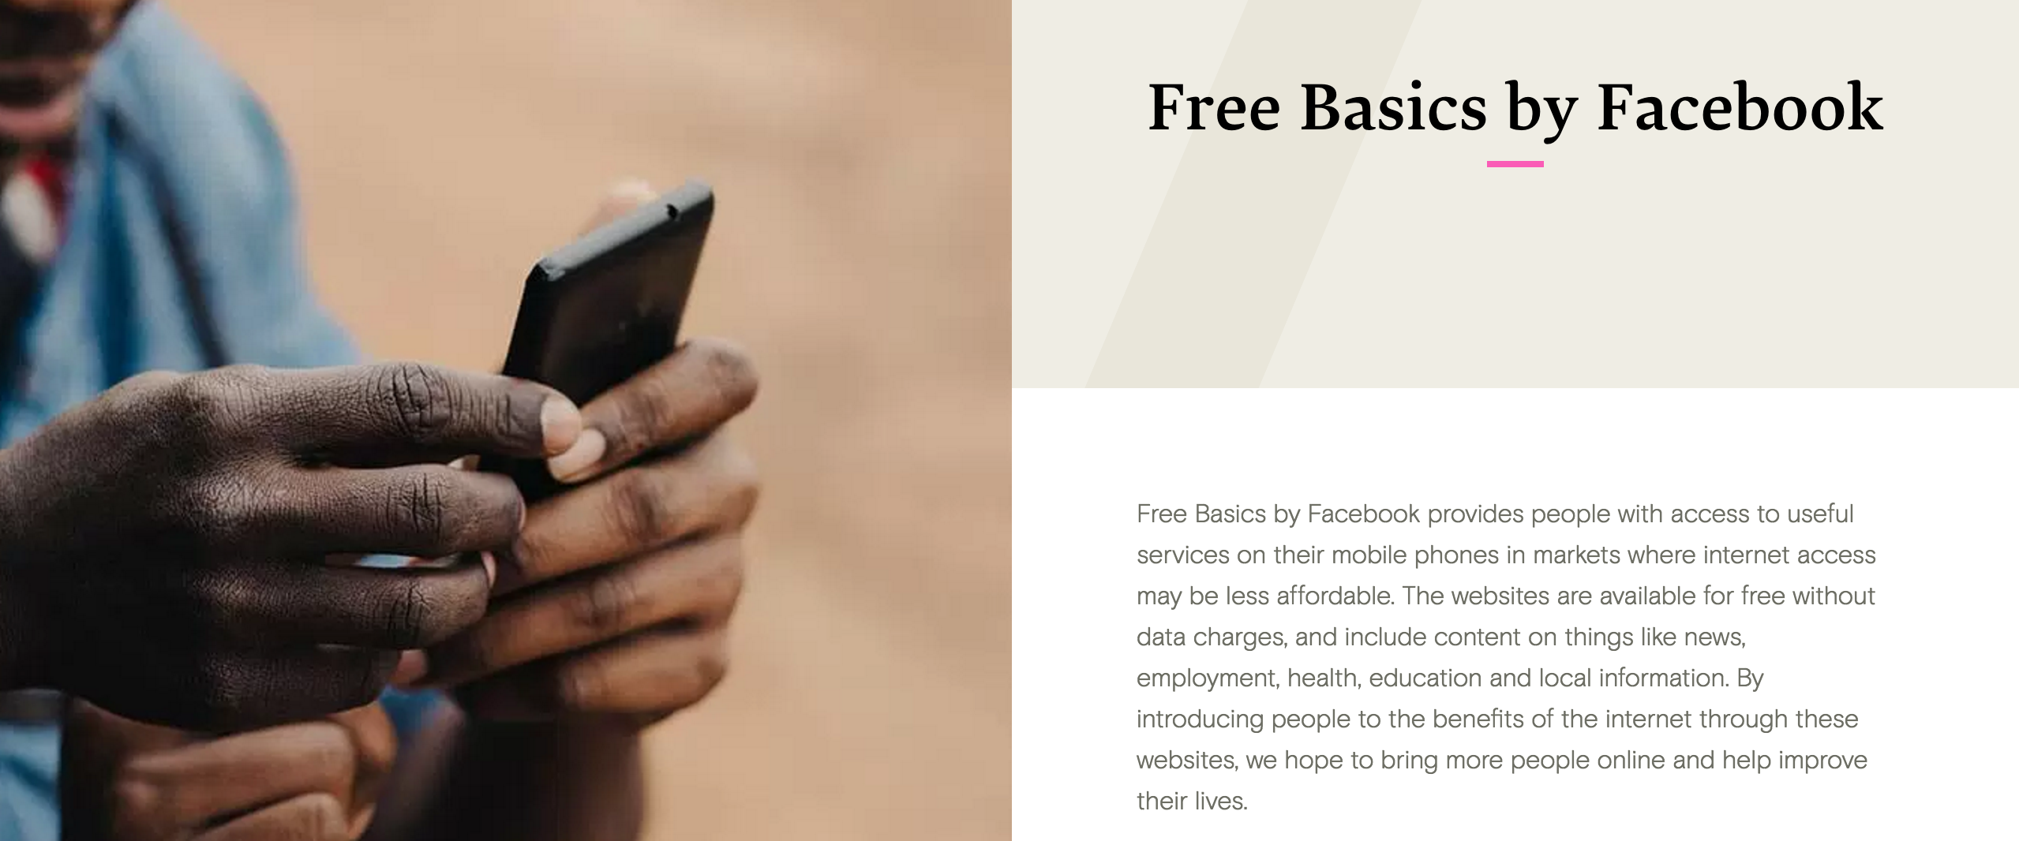
Facebook’s Free Basics – what is it?
Image from: https://info.internet.org/en/

Slide 5
Facebook’s Free Basics – what is it?
Image from: https://info.internet.org/en/

Slide 6
Facebook’s Free Basics – what is it?
Image from: https://info.internet.org/en/
Zero-rated web service offering, hoping to bridge digital divide.

Slide 7
Facebook’s Free Basics – where is it?

Slide 8
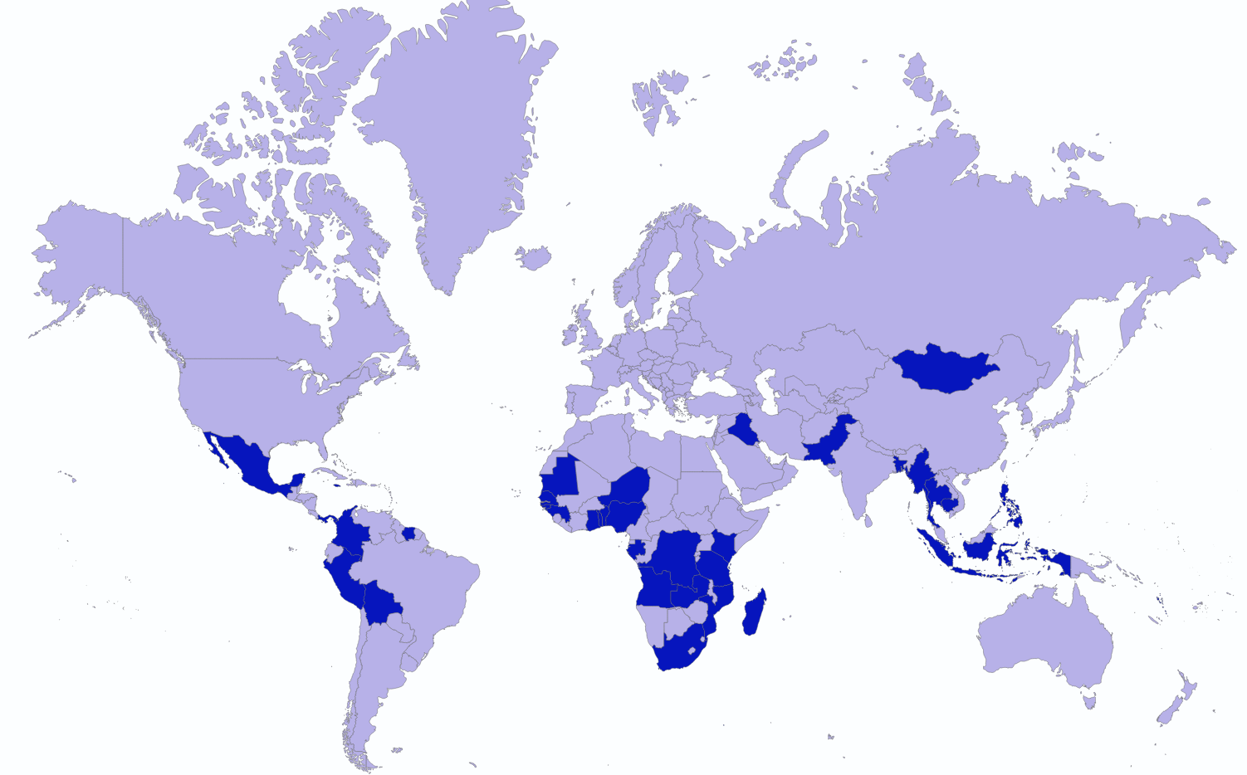
Facebook’s Free Basics – where is it?
63 countries in Asia, Africa,
South and Central America.

Slide 9
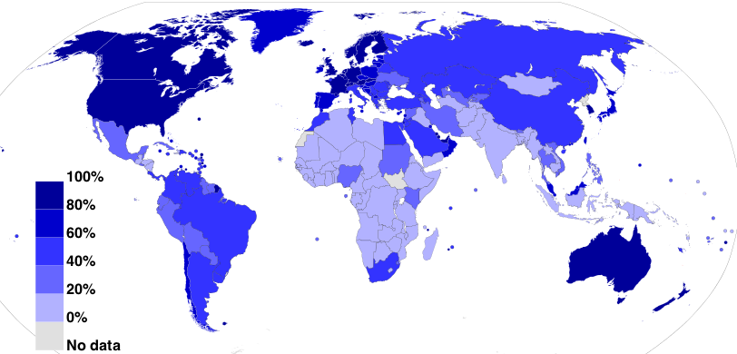
Facebook’s Free Basics – where is it?
63 countries in Asia, Africa,
South and Central America.
#Internet users as % of population International Telecommunications Union (2012).
Image from: https://commons.wikimedia.org/w/index.php?curid=19202338

Slide 10
Facebook’s Free Basics – where is it?
63 countries in Asia, Africa,
South and Central America.
#Internet users as % of population International Telecommunications Union (2012).
Image from: https://commons.wikimedia.org/w/index.php?curid=19202338
Free Basics is targeted to countries with low Internet penetration
(and potentially of interest to the ICTD research community).

Slide 11
& our three research questions

Slide 12
& our three research questions
I. What is on the menu?
# of free services
category of free services

Slide 13
& our three research questions
I. What is on the menu?
# of free services
category of free services
Experience Facebook’s gatekeeping procedure
II. How to become a chef or waiter here?

Slide 14
& our three research questions
I. What is on the menu?
# of free services
category of free services
Experience Facebook’s gatekeeping procedure
II. How to become a chef or waiter here?
III. Who are the visitors in this restaurant?
what countries, demographics and interests do they have?

Slide 15
Measurement methodology

Slide 16
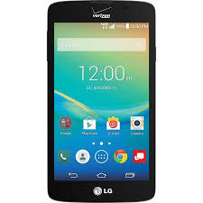
Measurement methodology
Architecture, according to Facebook
USER MOBILE

Slide 17
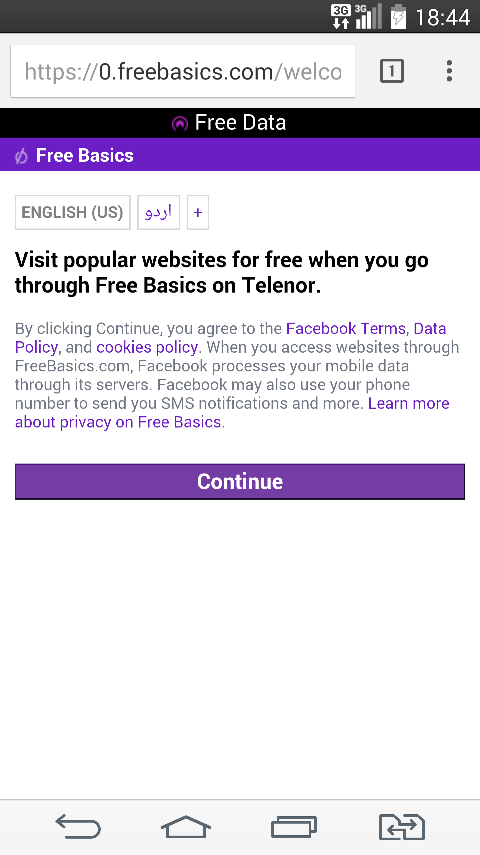
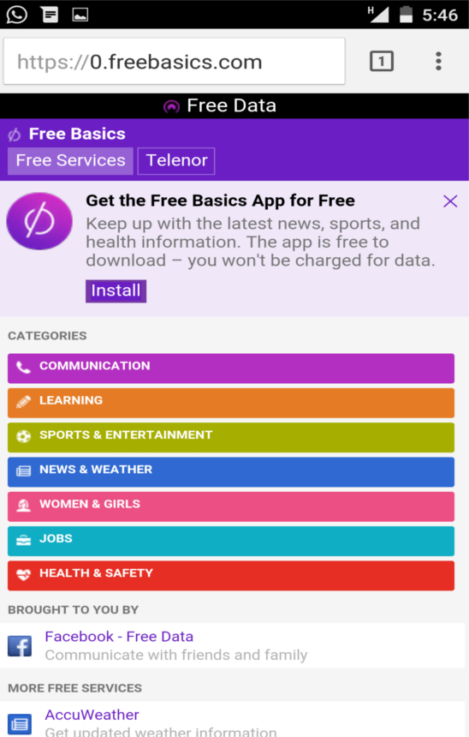
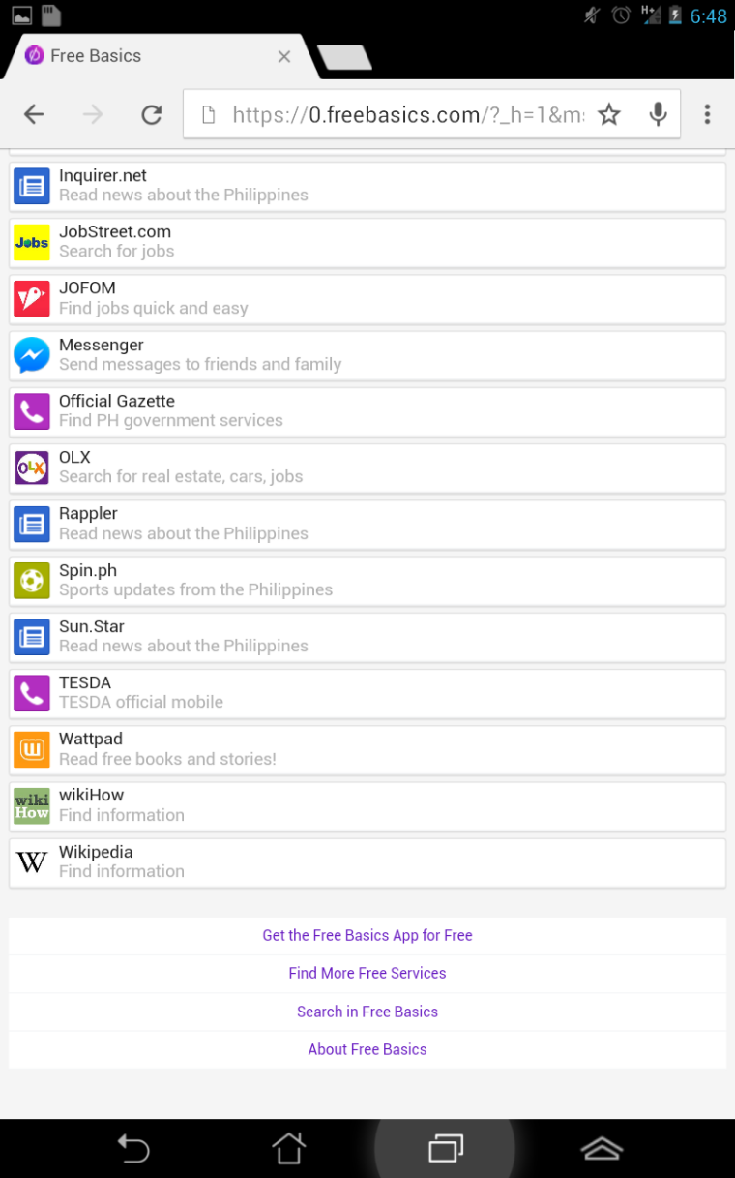
Measurement methodology
Architecture, according to Facebook
USER MOBILE
3
2
1

Slide 18
Measurement methodology
Architecture, according to Facebook
CELLULAR
PROVIDER
USER MOBILE

Slide 19
Measurement methodology
Architecture, according to Facebook
CELLULAR
PROVIDER
USER MOBILE
FACEBOOK
PROXY

Slide 20
Measurement methodology
BBC
Architecture, according to Facebook
CELLULAR
PROVIDER
BING
USER MOBILE
FACEBOOK
PROXY
WIKIPEDIA
WEBSERVICES

Slide 21
Challenging to measure

Slide 22
Challenging to measure

Slide 23
Challenging to measure
Measurement needs to be in specific countries, with particular cellular connections.

Slide 24
Measurement methodology
BBC
Architecture, according to Facebook
CELLULAR
PROVIDER
BING
Challenging to measure
USER MOBILE
FACEBOOK
PROXY
Android app to automatically crawl Free Basics webpage
Participant recruitment in 15 countries
Collection of service lists in different languages, across months
WIKIPEDIA
WEBSERVICES

Slide 25
I. What is on the menu?

Slide 26
I. What is on the menu?
Topic of services
Topic categorization of Free Basics services in different countries.
Learning, News & Weather, Health & Safety are the dominant topics in most countries.

Slide 27
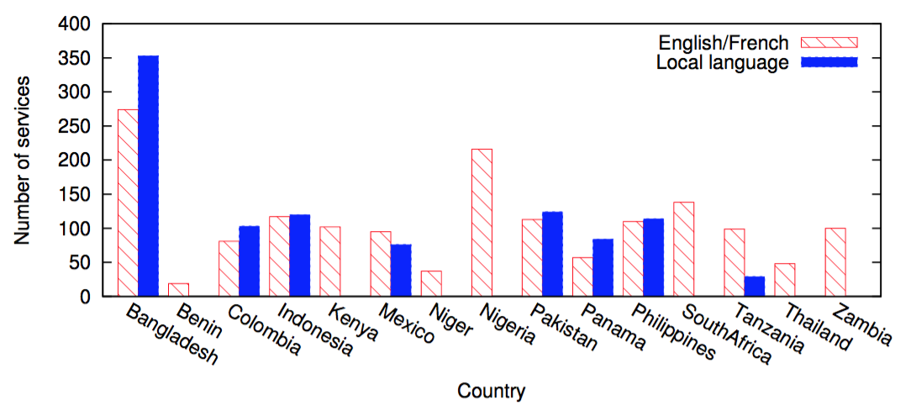
I. What is on the menu?
Number of services
Deployed services are highly customized in each country, with 80% of the observed services offered only in one country. Possibly proportional with local developer activity.

Slide 28
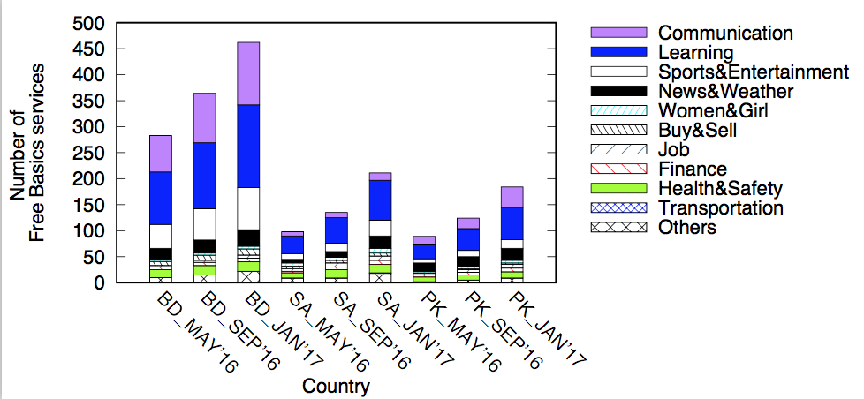
I. What is on the menu?
Growth of Services
Services growing rapidly, and are dominated by information services such as education, news, and health.
Between the nine months of May 2016 to January 2017, Bangladesh has added 179 new services, while South Africa has added 113 and Pakistan 95.

Slide 29
II. Experience Facebook’s gatekeeping

Slide 30
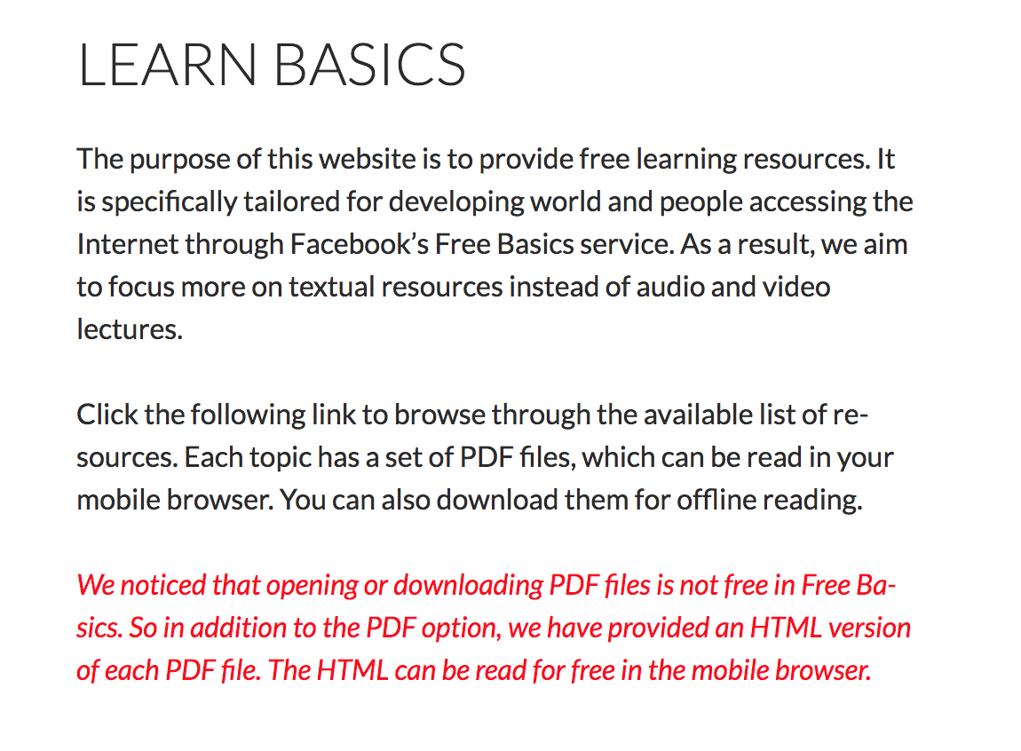
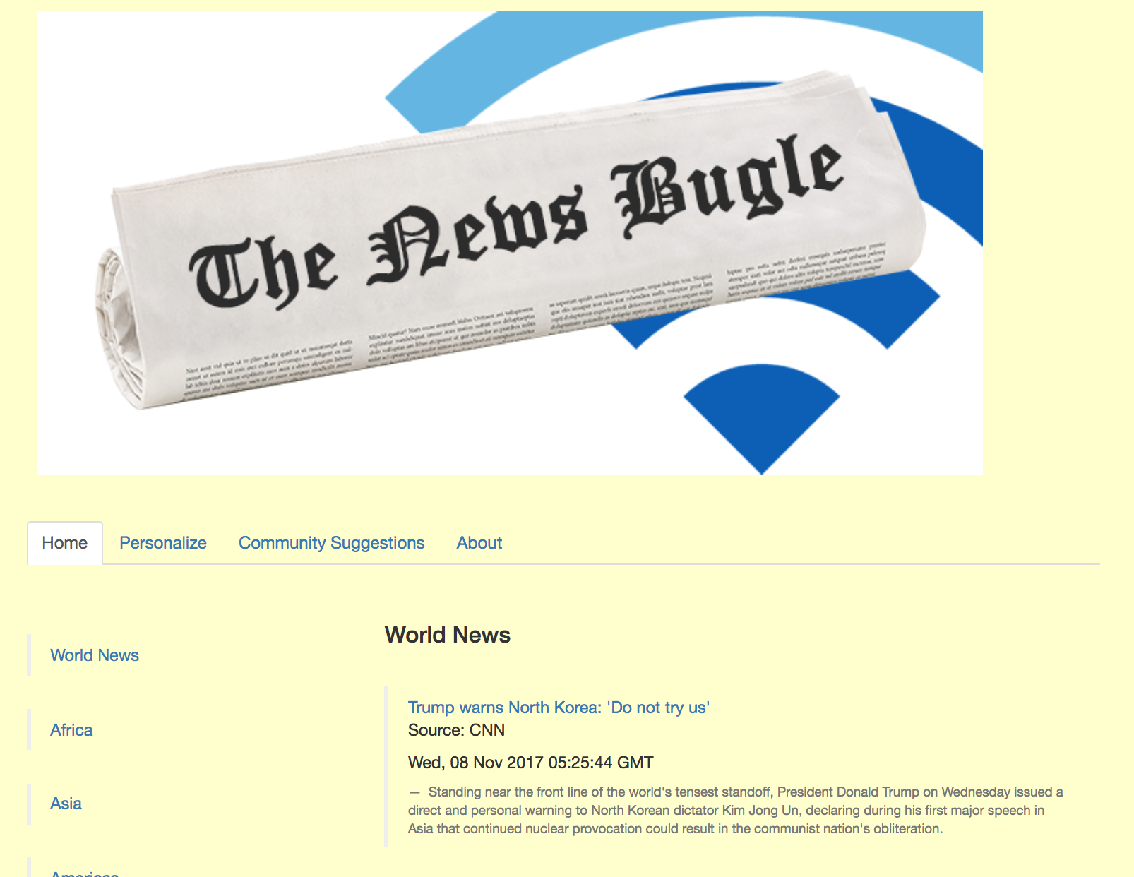
II. Experience Facebook’s gatekeeping
Deploying our own services
Offered in English since Jul 2, 2016.
Offered in English since Sep 17, 2016,
in Spanish and French since Dec 16, 2016.

Slide 31
II. Experience Facebook’s gatekeeping
Deploying our own services
Offered in English since Jul 2, 2016.
Offered in English since Sep 17, 2016,
in Spanish and French since Dec 16, 2016.
Took 1-2 weeks from application to going live, feedback was all technical (remove Javascript).

Slide 32
III. Who are the visitors?

Slide 33
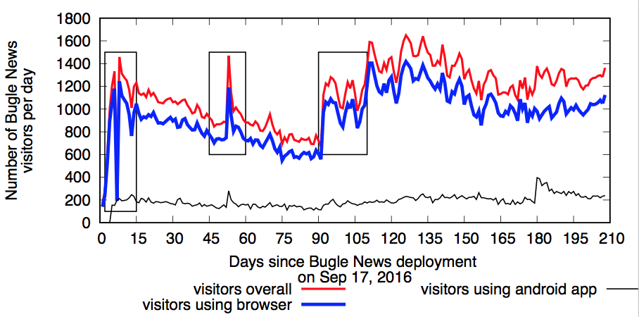
III. Who are the visitors?
.Free Basics users on Bugle News.
Bugle News attracted 95.6K unique visitors between Sep 2016 and Sep 2017.

Slide 34
III. Who are the visitors?
Free Basics service outage
US presidential election
Add French and Spanish support to Bugle News
.Free Basics users on Bugle News.
Bugle News attracted 95.6K unique visitors between Sep 2016 and Sep 2017.

Slide 35
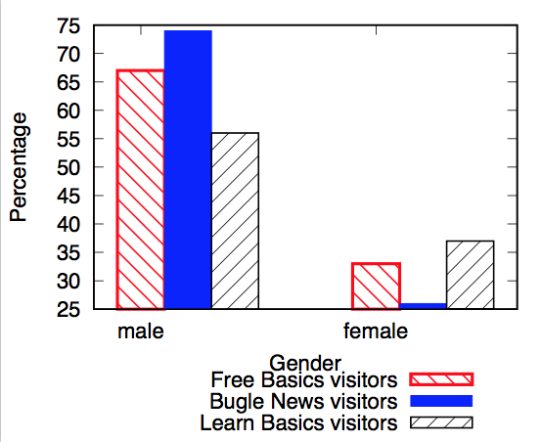
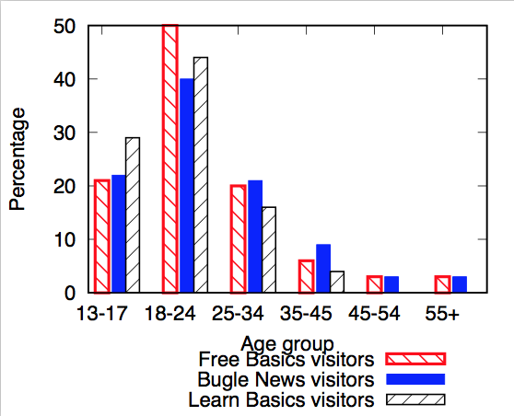
III. Who are the visitors?
Demographics of.Free Basics users on Bugle News.

Slide 36
III. Who are the visitors?
Demographics of.Free Basics users on Bugle News.
More interesting than the statistics, is how does the Free Basics developers’ portal show this information? Neither Free Basics nor our services need any entry of age/gender information.
From where is this inferred? Are there some data privacy implications?
Should there be more transparency?

Slide 37
III. Who are the visitors?
Country of.Free Basics users on Bugle News.
Bugle News has received visitors from 56 countries so far.
Mexico(MX), Zambia (ZM), Nigeria (NG), Philippines (PH), Pakistan (PK), South Africa (ZA), Iraq (IQ), Bangladesh (BD) and Thailand (TH) are some of the countries with highest number of requests per day

Slide 38
III. Who are the visitors?
Visitors from these countries after adding French/Spanish support – an effect of their colonial history.
Country of.Free Basics users on Bugle News.
Bugle News has received visitors from 56 countries so far.
Mexico(MX), Zambia (ZM), Nigeria (NG), Philippines (PH), Pakistan (PK), South Africa (ZA), Iraq (IQ), Bangladesh (BD) and Thailand (TH) are some of the countries with highest number of requests per day

Slide 39
III. Who are the visitors?

Slide 40
III. Who are the visitors?
Visitors show strong geographical affinity. Proportion of requests for the country’s specific news feed is high, while visitors show almost zero interest for other countries.
Useful insight for web service developers,
to understand the importance of including location specific content.

Slide 41
& our measurement based answers

Slide 42
& our measurement based answers
I. What is on the menu?
Excellent services on health, education, social awareness, news and other topics.
Free textbooks and online tutorials, useful information on how to combat Zika or Malaria, stories of woman empowerment
Many services in a specific country with locally relevant information, often in local languages.

Slide 43
& our measurement based answers
I. What is on the menu?
Excellent services on health, education, social awareness, news and other topics.
Free textbooks and online tutorials, useful information on how to combat Zika or Malaria, stories of woman empowerment
Many services in a specific country with locally relevant information, often in local languages.
II. How to become a chef or waiter here?
Fast and transparent process of service application and approval.
Bandwidth restriction and data privacy implications (IMC16, CCR17).
But there can be useful services which are not affected.

Slide 44
& our measurement based answers
I. What is on the menu?
Excellent services on health, education, social awareness, news and other topics.
Free textbooks and online tutorials, useful information on how to combat Zika or Malaria, stories of woman empowerment
Many services in a specific country with locally relevant information, often in local languages.
II. How to become a chef or waiter here?
Fast and transparent process of service application and approval.
Bandwidth restriction and data privacy implications (IMC16, CCR17).
But there can be useful services which are not affected.
III. Who are the visitors in this restaurant?
A simple RSS news aggregator service received 95.6K unique visitors, from 56 countries, without any advertisement!

Slide 45
Emboldened by these observations, we offered our first Free Basics service to create new information …..

Slide 46
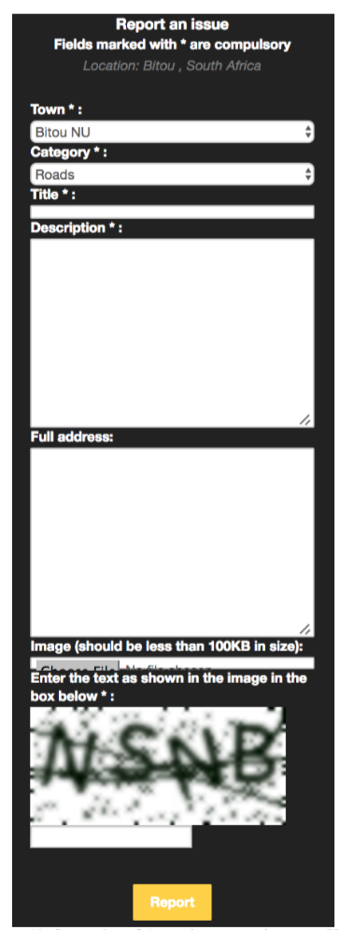
Awaaz: an ICTD service
Crowd-sourcing information about civic issues in developing countries.
Currently active in South Africa.
Includes a link where users can see issues reported so far, categorized by topics or by location.
Option to add comments, so that users can reinforce, negate or discuss issues reported by others.

Slide 47
Awaaz: an ICTD service
Road
Water
Electricity
94 unique issues reported between March and September, 2017.
All issues on http://myvoice.mpi-sws.org/all_reports

Slide 48
Future Work
Continue collection and processing of visitor data, to understand growing/fading interest in the program worldwide.
Offer Awaaz in other cities and countries, to see global proportion of civic issues.
Connect Awaaz issues to concerned authorities (help and collaboration appreciated!).
More in-depth study of privacy issues and security awareness of target population (many Awaaz users entered their mobile phones in the forms, without being asked!!).
Audit Free Basics 2.0 and see its effect on our currently deployed services
(will all of Internet be offered?).
Anyone interested in collaboration or having further questions,
please contact Rijurekha Sen at rijurekha@mpi-sws.org

